Slide 1
Clarks International
UK Retail
Diagnostic Report
March 2006
Strictly Private and Confidential

Slide 2
Report Contents
Page
Executive Summary
3
1
Background, Scope and Approach
26
2
Financial Analysis & Industry Drivers
31
3
Availability Findings
& Observations
40
4
Store Labour Findings & Observations
67
5
Opportunity Priorities & Roadmap
89
6
Prioritised Case for Action
96
7

Slide 3
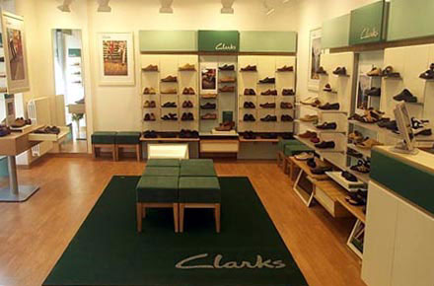
1
2
3
4
5
6
7
1
2
3
4
5
6
7
Executive Summary
Executive Summary
1
2
3
4
5
6
7
Executive Summary
Background Scope and Approach
Financial Analysis & Industry Drivers
Availability
Findings & Obser-vations
Store Labour
Findings & Obser-vations
Opportunity Priorities & Roadmap
Prioritised Case for Action

Slide 4
Project Objectives & Background
1
2
3
4
5
6
7
1
2
3
4
5
6
7
Executive Summary
The following diagnostic has been developed to identify opportunities for Clarks to enhance sales and profitability in its retail division
All proposed initiatives within this report have been developed with the specific intention of generating material improvement in the financial performance of the Clarks business through one or more of the four Business Benefit Areas shown in the diagram below
Whilst there appear to be a number of major opportunities for Clarks to consider, IBM has focused this diagnostic on 2 key areas: Availability & Margin and Store Process Efficiency / Store Operating Costs
Objectives & Background
Financial Analysis
Current v Potential
Availability: Findings & Recommendations
Business
Benefit Areas
Principle
Objective
Diagnostic Questions
Store Costs: Findings & Recommendations
Increase
Sales Revenue
Financial Performance
Availability & Margin
Roadmap &
Action Plan
Increase Gross
Margin
Increase
Shareholder
Value
Store Operating Costs
& Process Efficiency
Reduce Working Capital
Reduce Operating Costs

Slide 5
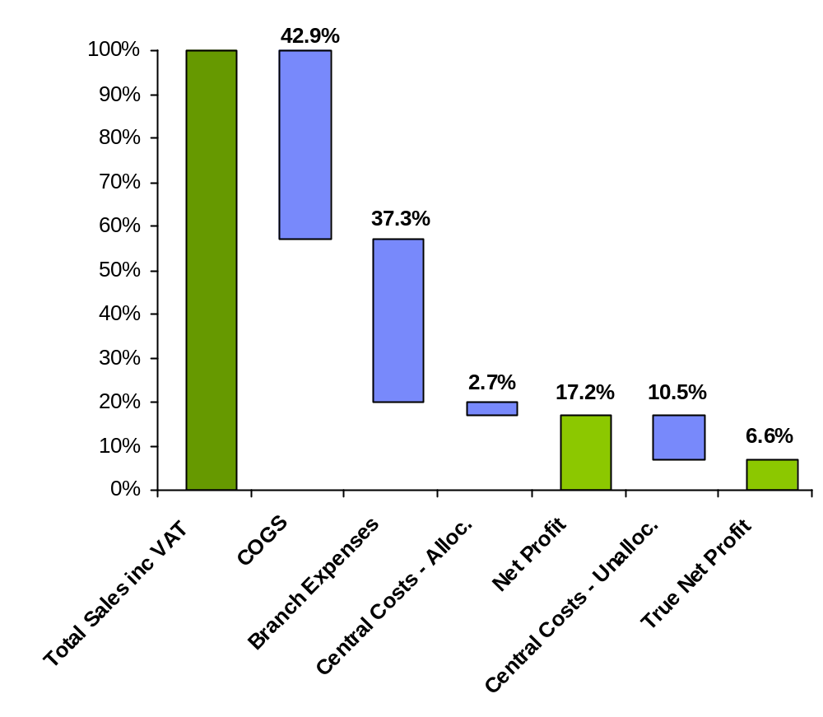
Financial Analysis – Current State
1
2
3
4
5
6
7
1
2
3
4
5
6
7
Executive Summary
Findings
Clarks sales growth has been marginal in recent years and the competition appears to have gained market share from Clarks
Despite a healthy bought-in margin, Clarks retail business does not retain this benefit at the EBIT line
Clarks stock also appears to turn at a slower rate than its competitors
Our high level analysis of the Clarks retail business indicates that branch expenses appear higher than industry averages. We would suggest a more detailed review be conducted on these expenses.
Central overhead and Occupancy costs need also to be reviewed in detailed to ascertain if they can be reduced (out of scope on this project)
IBM has focused this diagnostic review on these areas::
  Cost of non availability of stock on sales
  Impact of margin erosion
  Retail operating costs
Objectives & Background
Financial Analysis
Current v Potential
Availability: Findings & Recommendations
Store Costs: Findings & Recommendations
Roadmap &
Action Plan

Slide 6
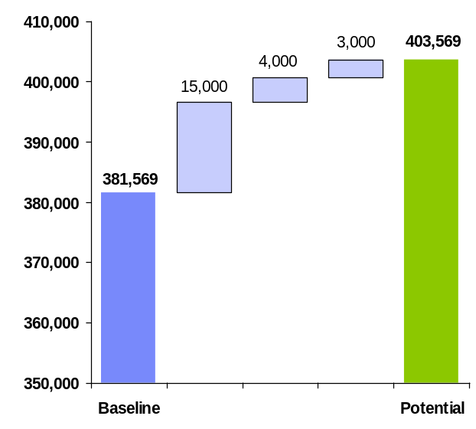
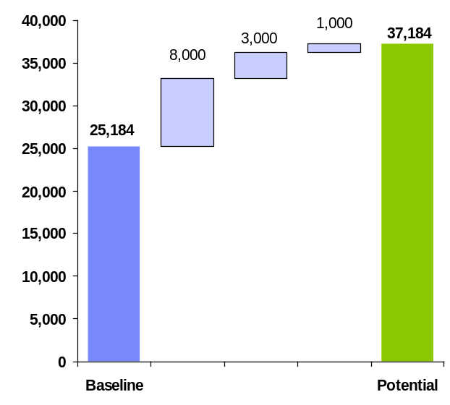
Financial Analysis – Potential Future State
1
2
3
4
5
6
7
1
2
3
4
5
6
7
Executive Summary
Increased Sales
Clarks current store replenishment model is unresponsive to customer demand, causing lost sales that can be conservatively estimated at £10 – £15m per annum
The upstream supply chain appears unresponsive to demand volatility. This can be demonstrated by potential lost sales of £2.5m - £4m
There is significant inaccuracy within store book stocks. Although this was out-of scope for this study, our high-level assessment indicates a potential lost sales of £2m - £3m
Objectives & Background
£22m or 5%
Sales Increase
Financial Analysis
Current v Potential
Availability: Findings & Recommendations
Store Costs: Findings & Recommendations
Increased Profit
Store operating costs appear high as a percentage of sales. Our recommendations contained within this report, indicate an increase in net profit of £5m - £8m is achievable
By improving control of margins, Clarks has the potential to increase profitability of its retail division by £2m - £3m
Clarks appears to be overstocked by up to 15%. The cashflow released from reducing this figure could between £10m - £15m per year. The increased profit from reduced cost of capital could be approximately £1m
Roadmap &
Action Plan
£12m or 50%
Profit Increase

Slide 7
Potential Future State: In Summary the Benefits Lie in …..
1
2
3
4
5
6
7
1
2
3
4
5
6
7
Executive Summary
Business
Benefit Areas
Increase in
Shareholder Value
Min Max
Objectives & Background
Improve Replenishment Processes
Improve Store Supply Chain
Increase
Sales Revenue
£15m
£20m
Financial Analysis
Current v Potential
Increase Book Stock Accuracy
Availability: Findings & Recommendations
Develop Responsive Supply Chain
Increase Gross
Margin
£3.5m
£5m
IBM Recommended Initiatives
Store Costs: Findings & Recommendations
Gain Control over Net Margins
Roadmap &
Action Plan
Reduce Stockholding
Reduce Working Capital
£10m
£20m
Improve Labour Management
Reduce Operating Costs
£5m
£8m
Challenge Inefficient Processes

Slide 8
Potential Future State: Unlocking the Benefits
1
2
3
4
5
6
7
1
2
3
4
5
6
7
Executive Summary
The key to realising the potential improvement, is to distil the opportunities identified into the five strategic programmes identified below
By committing board level ownership and accountability, and using a clear programme management methodology, the recommendations contained within this report can deliver significant benefit to the Clarks business through increased sales and profitability in the short term and longer term
Objectives & Background
Financial Analysis
Current v Potential
Summary of Initiatives
Major Strategic Programmes
Improve Replenishment Processes
Develop Next Generation Supply Chain
Availability: Findings & Recommendations
Improve Store Supply Chain
Simplify Range and Improve Product Profitability
Store Costs: Findings & Recommendations
Improve Book Stock Accuracy
Develop Responsive Supply Chain
Develop Retail-Focused Replenishment Model
Roadmap &
Action Plan
Gain Control over Net Margins
Reduce Stockholding
Provide Stores With the Tools to Manage Labour and Stock
Improve Labour Management
Detail review of all costs in retail organisation
Challenge Inefficient Processes

Slide 9
Findings & Recommendations: Availability
1
2
3
4
5
6
7
1
2
3
4
5
6
7
Executive Summary
Focus Area
Findings
Availability is not seen as a key business measure, and therefore does not have the profile it warrants within Clarks. We were not informed of any initiatives focusing on improving availability
Without such a focus, it will increase the time and challenges for Clarks to tackle the identified £20m lost sales opportunity
Objectives & Background
Measurement
Financial Analysis
Current v Potential
The replenishment model is too simplistic. There is no segmentation of SKUs to drive availability of key lines or stores. 5 day deliveries to store and long replenishment lead-times mean stores can often trade for several (peak) days without key styles and sizes
These factors compromise the ability to outperform store and SKU sales estimates and directly contributes to the lost sales figures noted above
Availability: Findings & Recommendations
Replenish
-ment
Store Costs: Findings & Recommendations
Roadmap &
Action Plan
The logistics operation is geared to cost optimisation. All stores receive the same service level, regardless of trading requirements: this again impacts lost sales
There is currently no incentive for logistics to trade-off cost and service for net business benefit
Store Deliveries
Store book stock accuracy is a fundamental driver of availability, yet stores do not have any visibility, control and thus ownership over their book stocks
Stores’ gross stock variance appears high and is potentially costing up to £3m in lost sales
Book Stock

Slide 10
Findings & Recommendations: Availability - continued
1
2
3
4
5
6
7
1
2
3
4
5
6
7
Executive Summary
Focus Area
Findings
Objectives & Background
Range
Complexity
The lead-times for DC replenishment are unresponsive to demand. This can lead to business-wide stockouts, particularly on ‘hot styles’, costing up to £4m in lost sales
The ‘tail’ of styles and thus SKUs is extremely long, increasing the risk of obsolescence
Financial Analysis
Current v Potential
Availability: Findings & Recommendations
28% of all styles sold on 2005 delivered a negative net margin. This is a broad and complex issue and impacts design and trading teams around responsibility and accountability for product profitability; These factors have a direct impact of at least £3m lost profit
The business appears to have between £10m - £20m in excess stock. We are informed that much of this stock lifecycle distressed; this has working capital and margin implications
Margin
Erosion
Store Costs: Findings & Recommendations
Roadmap &
Action Plan

Slide 11
Findings & Recommendations: Availability
1
2
3
4
5
6
7
1
2
3
4
5
6
7
Executive Summary
Focus Area
Summary of Key Recommendations
Objectives & Background
Measurement
Developing a robust measure for availability must be the first priority for the business across all supporting functions
Availability needs to have clear ownership and accountability at board level
Financial Analysis
Current v Potential
Review current processes and ascertain any quick wins within the current model
Complete a feasibility study for developing in a new replenishment model – processes and systems i.e. Investigate early polling of stores for certain store-SKUs to reduce lead-times, increased speed and frequency of replenishment for certain store-SKUs
Develop a segmented replenishment approach based on product behaviour
Availability: Findings & Recommendations
Replenishment
Store Costs: Findings & Recommendations
Roadmap &
Action Plan
Store Deliveries
Conduct a review of the timings of store deliveries and consider opportunities such as direct-store deliveries
Ascertain if forward visibility of allocated / despatched stock can be provided to stores
Book Stock
Investigate the causes of book stock variances
Ascertain if stores can be provided with the ability to manage their stock files
Business-wide stock visibility should be provided to improve customer service

Slide 12
Findings & Recommendations: Availability - continued
1
2
3
4
5
6
7
1
2
3
4
5
6
7
Executive Summary
Focus Area
Summary of Key Recommendations
Objectives & Background
Quantify and investigate the level of lifecycle distressed stock and develop processes to clear obsolete lines quickly.
Review stocking and mark down policy
Develop a policy to clear all seasonal/fashion stock to zero each season
Develop strategy and design for a more responsive upstream supply chain
Range
Complexity
Financial Analysis
Current v Potential
Availability: Findings & Recommendations
Margin
Erosion
Generate decision support tools to measure and improve product-level profitability
Conduct range review with a view to potential rationalisation of unprofitable styles
Store Costs: Findings & Recommendations
Roadmap &
Action Plan

Slide 13
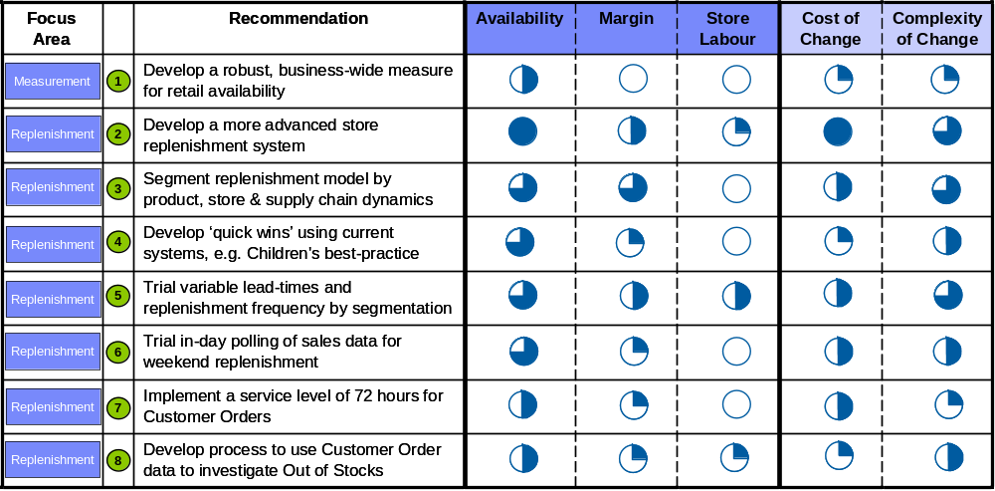
Availability: Summary of Recommendations & Business Impact
1
2
3
4
5
6
7
1
2
3
4
5
6
7
Executive Summary
Objectives & Background
Financial Analysis
Current v Potential
Availability: Findings & Recommendations
Store Costs: Findings & Recommendations
Roadmap &
Action Plan

Slide 14
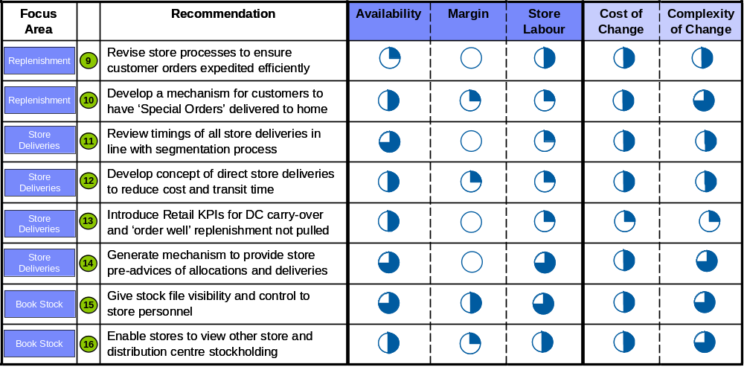
Availability: Summary of Recommendations & Business Impact
1
2
3
4
5
6
7
1
2
3
4
5
6
7
Executive Summary
Objectives & Background
Financial Analysis
Current v Potential
Availability: Findings & Recommendations
Store Costs: Findings & Recommendations
Roadmap &
Action Plan

Slide 15
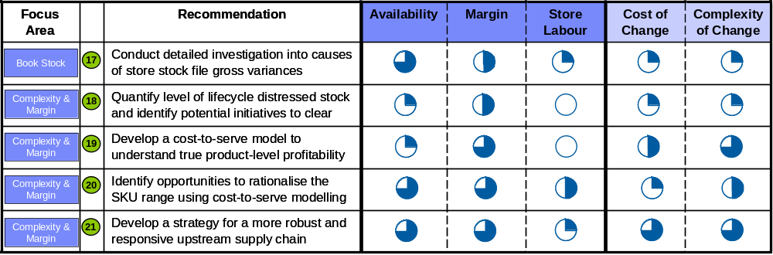
Availability: Summary of Recommendations & Business Impact
1
2
3
4
5
6
7
1
2
3
4
5
6
7
Executive Summary
Objectives & Background
Financial Analysis
Current v Potential
Availability: Findings & Recommendations
Store Costs: Findings & Recommendations
Roadmap &
Action Plan

Slide 16
Findings & Recommendations: Store Costs
1
2
3
4
5
6
7
1
2
3
4
5
6
7
Executive Summary
Focus Area
Findings
Clarks does not appear to drive any greater profit contribution or labour productivity from its larger stores. This is contrary to leading practice and most other successful speciality retailers. There appears to be significant cost reduction opportunities
By conducting internal benchmarking and sharing best practice, there is a potential prize for Clarks of some £5m increased profit in labour and other store areas. Benchmarking Clarks to other speciality retailers suggests the opportunity could be as much as £8m (2% reduction in cost as % sales)
Objectives & Background
Benchmarking
Financial Analysis
Current v Potential
Availability: Findings & Recommendations
Store Costs: Findings & Recommendations
Store staffing generally appears inflexible and this is partly due to the number of small stores and also due to the current labour mix across full-time, part-time, permanent and casual staff. This causes a direct loss of labour flexibility and directly influences store labour costs
Labour
Flexibility
Roadmap &
Action Plan
Separate processes exist in stores for labour scheduling, STARS and payroll, causing significant inefficiency. The opportunity has been estimated at £0.2m
There is little in the way of quality management information which may drive further savings beyond the figures identified in benchmarking. Further detailed analysis needs to be performed to ascertain further opportunities for savings
Turnover of staff and management in store is a sizeable issue, impacting on customer service, sales, operational productivity and costs
Labour
Management

Slide 17
Findings & Recommendations: Store Costs - Continued
1
2
3
4
5
6
7
1
2
3
4
5
6
7
Executive Summary
Focus Area
Findings
Objectives & Background
Stores do not have the ability to effectively manage stock, and therefore spend a large amount of time on manual stock management processes. Labour efficiency and suffers directly from lack of stock visibility and we estimate potential savings up to £0.5m
Store stock deliveries are not made in a manner that minimises store costs. In particular, the configuration, information flows and timings of deliveries negatively impacts store costs. This causes rework in store prior to putaway and our high level estimates indicate that this cost stores up to £0.8m per annum
Financial Analysis
Current v Potential
Store Stock
Management
Availability: Findings & Recommendations
Store Costs: Findings & Recommendations
Customer
Service
Up to 7 hours per store per week is spent handling telephone calls. A reduction through improved stock availability and alternative customer communication channels could reduce costs by up to £0.2m per annum
Roadmap &
Action Plan

Slide 18
Findings & Recommendations: Store Costs
1
2
3
4
5
6
7
1
2
3
4
5
6
7
Executive Summary
Focus Area
Summary of Key Recommendations
Define key performance metrics and conduct an internal benchmarking exercise. Benchmarking will provide a set of ‘quick wins’ to realise cost reductions
Consider the possibility of store manager incentives linked to benchmarks
Build on the existing Torex data to develop a Labour Management Programme. This should incorporate a Store Manager Toolkit to support optimal scheduling
Objectives & Background
Benchmarking
Financial Analysis
Current v Potential
Labour
Flexibility
Develop a mechanism for understanding optimal labour mix of full-time / part-time labour and temporary / permanent contracts. Store Manager Toolkit must enable hiring and scheduling of employees in accordance with demand
Availability: Findings & Recommendations
Review tools and methods currently used in the store base, identifying and sharing best-practices to streamline current process
Examine the potential for a single system deployed in store to bring together Rostering, Labour Management and Time & Attendance
Develop framework to understand causes of attrition, particularly for management
The profile and importance of stores must be increased throughout the business
Store Costs: Findings & Recommendations
Labour
Management
Roadmap &
Action Plan
Store Stock
Management
Provide stores with stock visibility to enable them to streamline manual processes
Engage logistics and consider case for improved store-friendliness of delivery configuration, timings of delivery and volume pre-advices
Customer
Service
Improved at-store availability will reduce stores’ need to place customer orders
Investigate potential for centralised call handling for store queries

Slide 19
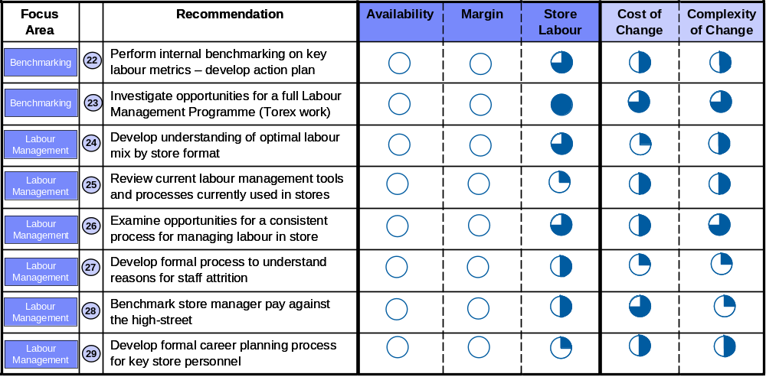
Store Costs: Summary of Recommendations & Business Impact
1
2
3
4
5
6
7
1
2
3
4
5
6
7
Executive Summary
Objectives & Background
Financial Analysis
Current v Potential
Availability: Findings & Recommendations
Store Costs: Findings & Recommendations
Roadmap &
Action Plan

Slide 20
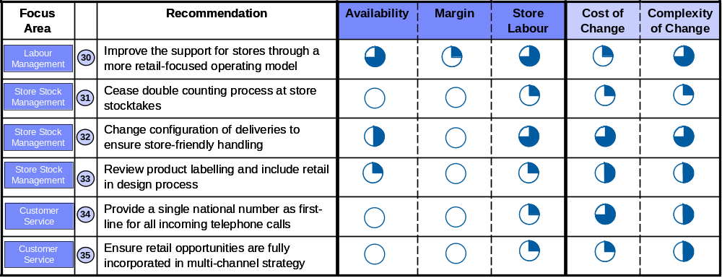
Store Costs:
Summary of Recommendations & Business Impact
1
2
3
4
5
6
7
1
2
3
4
5
6
7
Executive Summary
Objectives & Background
Financial Analysis
Current v Potential
Availability: Findings & Recommendations
Store Costs: Findings & Recommendations
Roadmap &
Action Plan

Slide 21
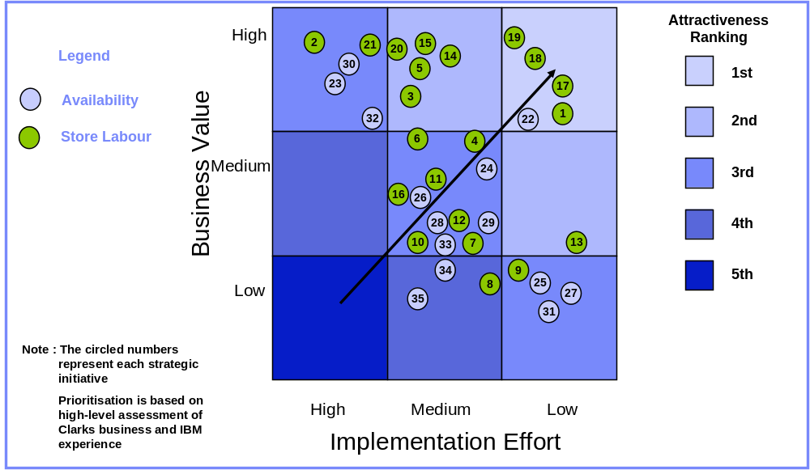
Prioritisation of Recommendations
1
2
3
4
5
6
7
1
2
3
4
5
6
7
Executive Summary
Objectives & Background
Financial Analysis
Current v Potential
Availability: Findings & Recommendations
Store Costs: Findings & Recommendations
Roadmap &
Action Plan

Slide 22

Roadmap – Phase 1
1
2
3
4
5
6
7
1
2
3
4
5
6
7
Executive Summary
A phased programme of activity is proposed for Clarks in order to undertake the necessary process and other structure initiatives that are required to drive greater performance and in the longer term, enhanced Retailer sales and profits.
Phase 1
‘‘What are our quick wins?’
  Robust measure for availability
  Short-term replenishment ‘quick wins’
  KPIs for DC stock carry over and order well
  72 hour lead-time for customer orders
  Investigate causes of gross stock variance
  Quantify lifecycle distress and plan to clear
  Conduct store labour benchmarking
  Formal process to understand staff attrition
  Benchmark manager T’s and C’s
  Formal career planning for store personnel
  Remove double counting from stocktake
  Product labelling
Q1 - 06
Q2 - 06
Q3 - 06
Q4 - 06
Q1 - 07
Q2 - 07
Q3 - 07
Q4 - 07
1
4
13
7
17
18
22
27
28
29
31
33
Milestones:
Fusion ‘Go-Live’
CIPR1 / Release 3a
CIPR 2

Slide 23
Roadmap – Phase 2
1
2
3
4
5
6
7
1
2
3
4
5
6
7
Executive Summary
A phased programme of activity is proposed for Clarks in order to undertake the necessary process and other structure initiatives that are required to drive greater performance and in the longer term, enhanced Retailer sales and profits.
Phase 2
‘What are the tactical initiatives?’
  Segmented replenishment model
  Variable delivery frequency and lead-times
  Customer order availability measure
  Direct store deliveries
  Stockfile visibility and control
  Review and revise store delivery schedules
  Pre-advice for allocated & despatched stock
  Process revision for customer orders
  Cost-to-Serve modelling
  Understand optimal store labour mix
  Labour management tools
  Consistent store labour processes
  Store-friendly deliveries
  Single national call-centre
Q1 - 06
Q2 - 06
Q3 - 06
Q4 - 06
Q1 - 07
Q2 - 07
Q3 - 07
Q4 - 07
3
5
8
12
15
11
14
9
19
24
25
26
32
34
Milestones:
Fusion ‘Go-Live’
CIPR1 / Release 3a
CIPR 2

Slide 24
Roadmap – Phase 3
1
2
3
4
5
6
7
1
2
3
4
5
6
7
Executive Summary
A phased programme of activity is proposed for Clarks in order to undertake the necessary process and other structure initiatives that are required to drive greater performance and in the longer term, enhanced Retailer sales and profits.
Phase 3
What are the strategic initiatives?’
Visibility of stock by location
Advanced replenishment system
In-day sales polling
Home delivery for customer orders (as part of multi-channel strategy)
Range rationalisation
Strategic review of upstream supply chain
Labour management programme
Improve retail-focus of central functions
Retail consultation in multi-channel
Q1 - 06
Q2 - 06
Q3 - 06
Q4 - 06
Q1 - 07
Q2 - 07
Q3 - 07
Q4 - 07
16
2
6
10
20
21
23
30
35
Milestones:
Fusion ‘Go-Live’
CIPR1 / Release 3a
CIPR 2

Slide 25
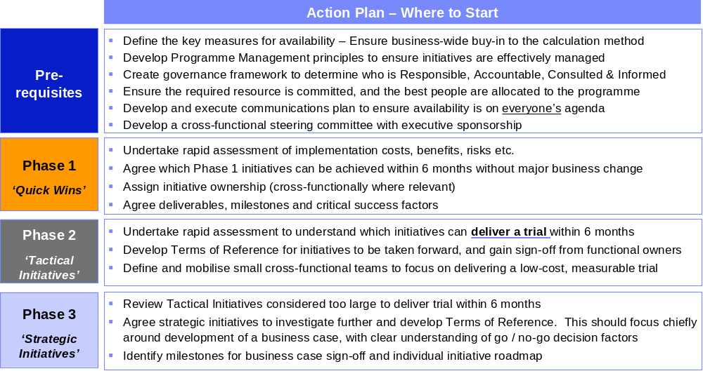
Action Plan
1
2
3
4
5
6
7
1
2
3
4
5
6
7
Executive Summary
Objectives & Background
Financial Analysis
Current v Potential
Availability: Findings & Recommendations
Store Costs: Findings & Recommendations
Roadmap &
Action Plan

Slide 26
1
2
3
4
5
6
7
1
2
3
4
5
6
7
Background, Scope & Approach
Background, Scope & Approach
1
2
3
4
5
6
7
Executive Summary
Background Scope and Approach
Financial Analysis & Industry Drivers
Availability
Findings & Obser-vations
Store Labour
Findings & Obser-vations
Opportunity Priorities & Roadmap
Prioritised Case for Action

Slide 27
Background to this Report
1
2
3
4
5
6
7
1
2
3
4
5
6
7
Background, Scope & Approach
Summary of Key Themes from Initial Workshop from Clarks employees
Retail Strategy
  Clarks business has grown primarily from a wholesale business, and thus does not always operate as a typical retailer
  The Top 100 stores return 48% of total retail sales (but only 41% of the profit); Many successful retailers have a much higher proportion of profit form their top stores
  Market conditions including competition from the supermarkets have caused erosion of market share in Men’s and Women’s categories
  There is a feeling that cost pressure rather than driving sales is the greater imperative for the Clarks retail business
Range Profile:
  The Top 20 lines account for approximately 25% (Men's) 21% (Women's) and 18% (Children's) of sales volume
  Significant risk and complexity exists around managing end-sizes
  There is a large ‘tail’ of slow and non-moving SKUs in the business
Supply Chain
  Supply chain is geared towards internal operating efficiency. This causes sub-optimal retail operations
  There is currently no robust, business-wide figure for measuring at-store availability
  It is estimated that stockholding is around 14 weeks in store
  Replenishments will typically be made on a Day 1 for Day 3 cycle
  Store deliveries are made 5 days per week (but larger stores operate 7 days per week)
Retail Operations
  Store processes have not changed significantly for many years
  Clarks pay store staff minimum wage. Increases are dictated by legislation and therefore difficult to plan for.
  Staff turnover is running at approximately 40%. (Many high street retailers operate with greater than 50%) Turnover of management >30%( Many high street retailers are in excess of 35%)
  The rate of personnel churn can lead to poor retailing disciplines, with no obvious best-practice adherence
  Store labour costs as a % of sales is 14.1% (which is up to 2% above many speciality retailers)

Slide 28
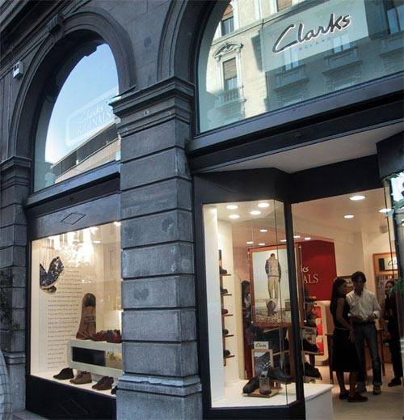
Scope of This Review
1
2
3
4
5
6
7
1
2
3
4
5
6
7
Background, Scope & Approach
Objectives
Identify opportunities to realise savings in Clarks’ store operating costs?
Identify cost saving opportunities from process efficiency gains in the store and secondary supply chain?
Assess the current state of sales, availability and margin erosion. Provide insight into opportunity areas for Clarks to increase revenues and net profit
Provide a set of quantified ‘quick wins’ and a number of larger-scale business improvement opportunities
Scope
High-level analysis of key store processes and performance
Clarks UK retail division only. Wholesale and franchise operations are out-of-scope
A sample size of 4 stores for qualitative analysis
Detailed quantitative analysis covering the entire store portfolio

Slide 29
Approach - Diagnostic Methodology for Clarks
1
2
3
4
5
6
7
1
2
3
4
5
6
7
Background, Scope & Approach
Mobilisation
Data Capture & Analysis
Recommendations
Report
Understand
Project Plan
& Approach
Customise the methodology to Clarks needs
Data Capture - Site Visits & Systems Extraction
  Capture KPI’s & Financial data
  Identify Operating Practices & Differences to Standards
  Interviews Key Managers
  Extract POS, stock and product data from core systems
Develop Recommendations
  Evaluate Opportunities
  Assess Financial impact
  Validate Recommendations
Develop objectives, timescales and deliverables.
Establish resource requirements
Prioritise & Plan Initiatives
  Assess feasibility of opportunities
  Link with Value Drivers
  Plan Implementation & Assess Risks
Analysis - Financial
  Key KPI’s .. Sales, stock, operating costs, etc
  Internal Benchmarking … store vs store
  External benchmarking …Clarks vs Industry Ranges
Define data specification and scope of interviews
Understand risks & issues
Develop & Present Final Report
  Executive Summary
  Leading Practices & Benchmark Comparisons
  Findings & Recommendations
  Prioritised Roadmap
Analysis - Data
  Identify Issues & assess business impact
  Compare to Leading Practices - Internal & External
  Identify Gaps & improvement opportunities
Generate Stakeholder Management Plan
Generate detailed
Project Plan

Slide 30
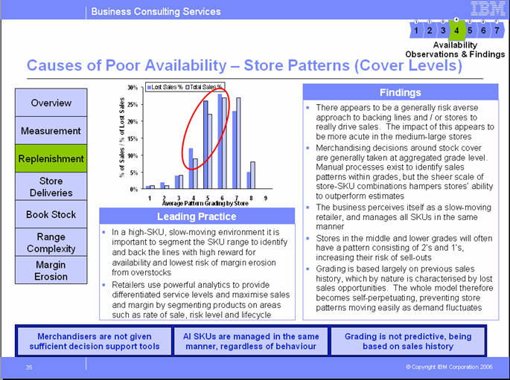
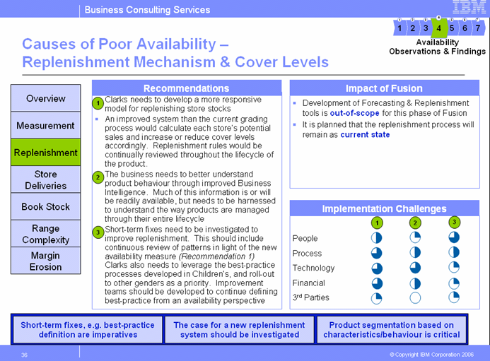
Approach – Report Structure
1
2
3
4
5
6
7
1
2
3
4
5
6
7
Background, Scope & Approach
Findings: Our observations from the interviews and data analysis conducted
Leading Practice: How other retailers have tackled the issues facing Clarks
Key messages from
our findings
Impact of Fusion: Ensures alignment with the current programme
Recommendations: Identification of potential initiatives Clarks should consider
Implementation Challenges: High-level assessment of the scale of change
= High level of change
= Minimal / no change
Key messages from the recommendations

Slide 31
1
2
3
4
5
6
7
1
2
3
4
5
6
7
Financial Analysis
& Industry Drivers
Financial Analysis
& Industry Drivers
1
2
3
4
5
6
7
Executive Summary
Background Scope and Approach
Financial Analysis & Industry Drivers
Availability
Findings & Obser-vations
Store Costs
Findings & Obser-vations
Opportunity Priorities & Roadmap
Prioritised Case for Action

Slide 32
Financial Analysis
1
2
3
4
5
6
7
1
2
3
4
5
6
7
Financial Analysis
& Industry Drivers
Overview
Findings
Sales Growth
Clarks sales growth has been marginal in recent years. The competition appears to have been able to gain market share at Clarks’ expense
Despite a healthy bought-in margin, Clarks does not retail this benefit down to the EBIT level in the Profit and Loss due to apparent higher store costs
Clarks stock also appears to turn at a slower rate than its competitors
Industry experts expect the footwear market to grow over the next few years, but see competition from the value players as a major threat
Our high level review indicates that store operating costs are higher than industry benchmarks
In order to compete and regain market share, Clarks will need to be able to reduce costs, increase sales and maximise gross margin to drive overall net profitability
IBM has focused its analysis on two key contributors to this lost profit opportunity: Cost of non availability and retail operating costs
Profitability
Stock Turn
Customer Service
Industry Drivers
Market share is being
significantly eroded by competition
The cost base for Clarks retail is uncompetitive
Store costs and availability & margin are key opportunity areas

Slide 33
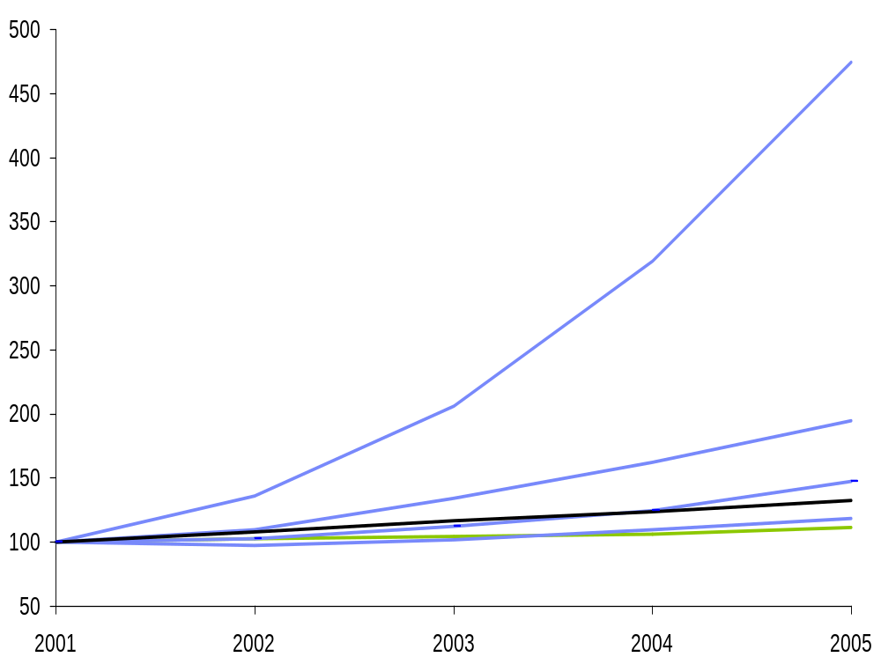




Clarks Business Performance: Sales Growth
1
2
3
4
5
6
7
1
2
3
4
5
6
7
Financial Analysis
& Industry Drivers
Overview
Findings
Retailer D
Clarks static sales growth indicates the fact that market share has been lost in adults and remains static in children’s shoes
If Clarks were to grow at the rate of other speciality retailers, revenues would have grown to £840m
Verdict Research predicts growth of 19.6% in footwear specialists’ sales from 2005 – 2010. It is vital Clarks is positioned to secure as much of this additional revenue as possible
Sales Growth
Profitability
Stock Turn
Customer Service
Retailer C
Retailer E
Industry Drivers
Ave. Growth
Retailer A
Clarks
Source: Bureau van Dijk - FAME
Clarks sales growth has been flat, resulting in loss of market share
Verdict Research predicts the market will grow in the next 5 years
Clarks needs to maximise its chances of winning that business

Slide 34
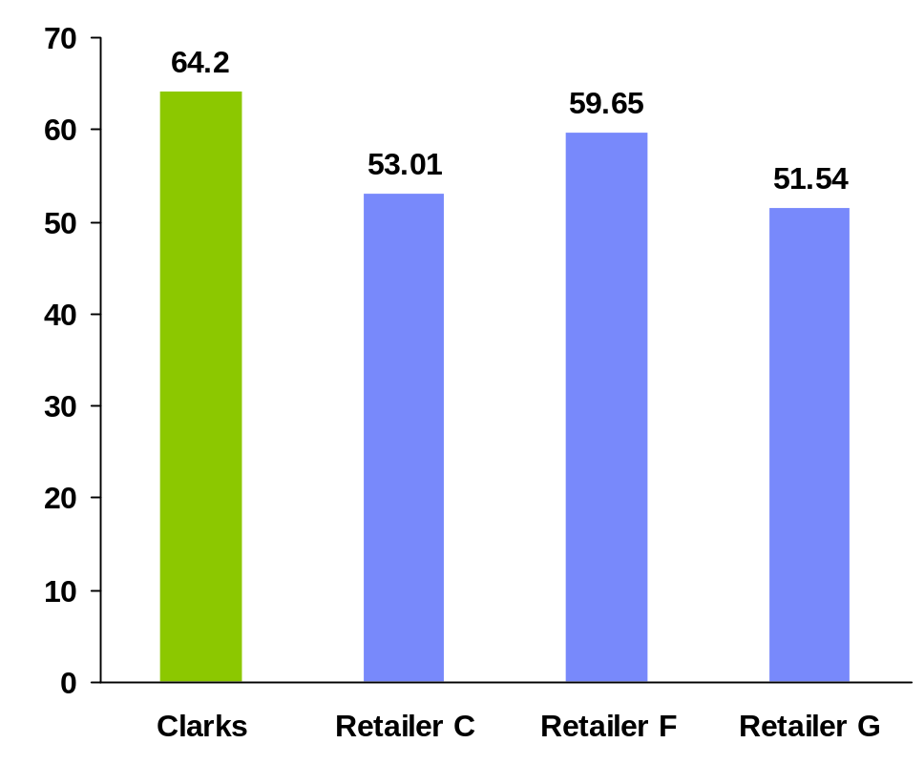
Clarks Business Performance: Gross Margin
1
2
3
4
5
6
7
1
2
3
4
5
6
7
Financial Analysis
& Industry Drivers
Overview
Findings
Research indicates that In terms of gross margin achieved, Clarks outperforms its high street competitors by a min of 5%
The fact that Clarks is a 100% own-label retailer allows greater control over bought-in margin
Operating in the ‘middle market’ ensures Clarks does not compete directly in the low-margin, high volume space with the likes of Asda George and Matalan (although these retailers do pose a real threat to Clarks market share)
Sales Growth
Profitability
Stock Turn
Customer Service
Industry Drivers
Source: Bureau van Dijk - FAME
Gross Margin is favourable in comparison with the competition
100% own-label facilitates
strong bought-in margin
Price competition will put pressure on current Gross Margin

Slide 35
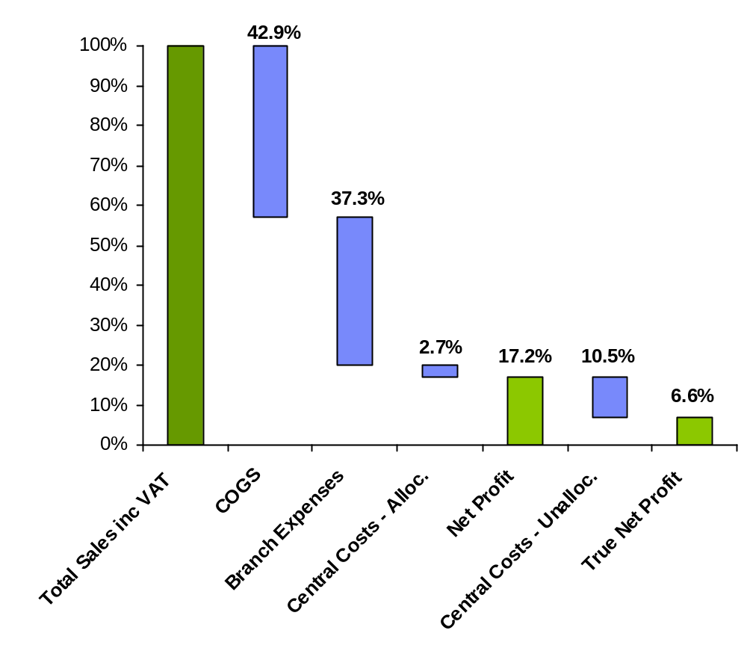
Clarks Business Performance: Key Cost Components
1
2
3
4
5
6
7
1
2
3
4
5
6
7
Financial Analysis
& Industry Drivers
Overview
Findings
This review covers the labour aspect of branch costs.
External benchmarks suggest Clarks should
conduct a review of other branch costs
Using the Management Information Pack for the 11 months to 31st December 2005, IBM has calculated the estimated net margin for Clarks retail operations
Branch expenses appear high and more detailed analysis needs to be performed. Costs could be approx. 2%. Higher than other similar speciality retailers. It may well be more with a more detailed review
There is a central cost reallocation of 2.7% in the retail accounts, but for benchmarking purposes, we believe there is a further 10.5% cost of sales that can should be included This reflects a volume-based apportionment of all other central overheads. Further work needs to be done in this area to determine the most appropriate method of allocating these costs
Distribution costs have been estimated within the unallocated costs at 4.17%. There is no pass through of these costs to retail. This incentivises logistics to optimise cost over service
Sales Growth
Profitability
Consider a review of central costs.
These appear high even though
Clarks is an own-brand retailer
Stock Turn
Customer Service
Industry Drivers
Comparable net margin for
Clarks Retail of 6.6%
Branch expenses appear higher than the industry average
There is a disincentive for logistics to prioritise service over cost

Slide 36
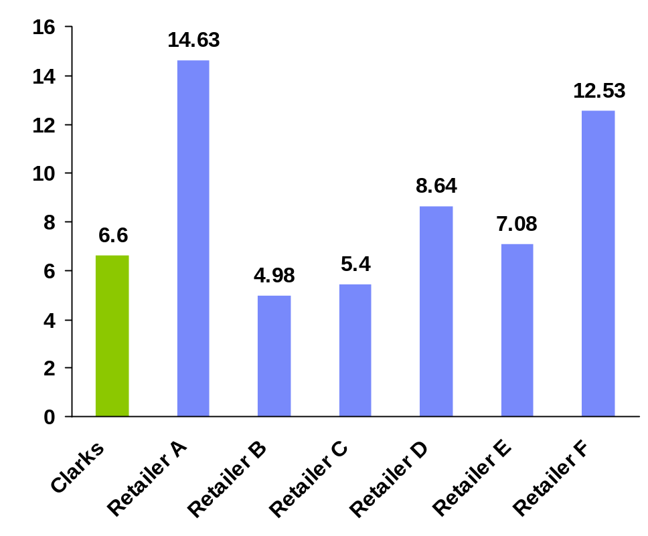
Clarks Business Performance: % EBIT
1
2
3
4
5
6
7
1
2
3
4
5
6
7
Financial Analysis
& Industry Drivers
Overview
Findings
The Clarks EBIT figure of 6.6% is calculated by assigning a proportionate share of all central costs to retail
In light of the favourable gross margin illustrated previously, Clarks net profit figure is less positive. If Clarks could generate an EBIT of 10% this would drive incremental profit of approx £13.0m
This discrepancy suggests that Clarks operating costs may become un-competitive or may not allow profits to be maximised for shareholders
Naturally retail operations are the largest single cost area; tackling these gives Clarks a real opportunity to increase net profitability.
Sales Growth
Profitability
Stock Turn
Customer Service
Industry Drivers
Source: Bureau van Dijk - FAME
Clarks Retail EBIT compares unfavourably with the competition
All Gross Margin benefit is eroded
Indicates Clarks operating costs
are uncompetitive

Slide 37
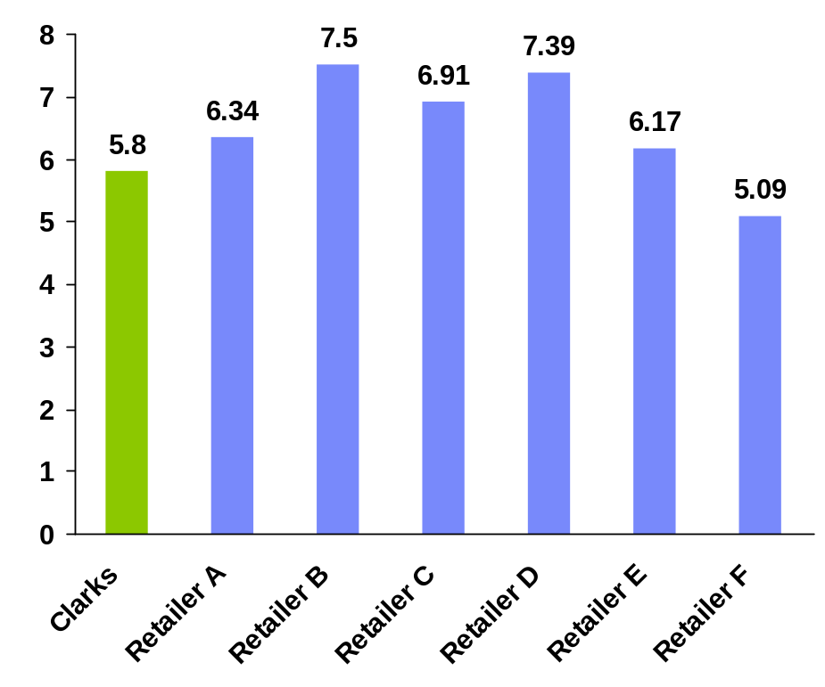
Clarks Business Performance: Stock Turn
1
2
3
4
5
6
7
1
2
3
4
5
6
7
Financial Analysis
& Industry Drivers
Overview
Findings
The competitor stock turn analysis is based on closing stock v sales
Clarks retail stock turns approximately 5.8 times per year. By achieving a further stock turn, Clarks would be able to reduce working capital by £6m and achieve a reduction in cost of capital of around £0.5m
Retail competitors’ figures include both DC and store stock, whereas Clarks refers to retail only
The adverse comparison with high-street competitors may be symptomatic of the breadth of SKU range (both in styles and sizes offered)
Clarks needs to investigate the profile of stock in more detail to gain greater understanding of root causes
Sales Growth
Profitability
Stock Turn
Customer Service
Industry Drivers
Source: Bureau van Dijk - FAME
Clarks stockturn compares unfavourably with the competition
Analysis does not include Clarks DC stock, so gap is greater
Product analysis essential to understand root causes

Slide 38
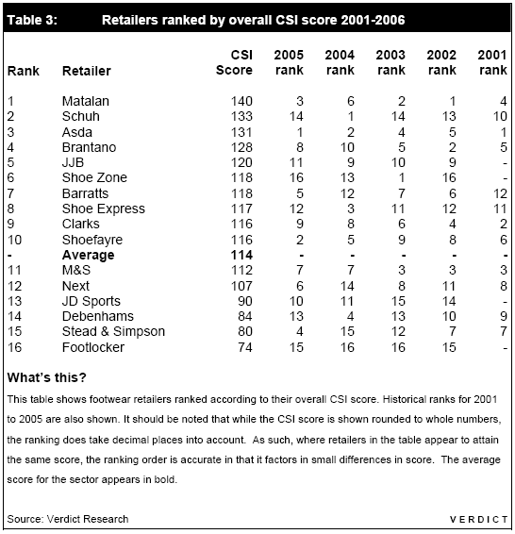
Clarks Business Performance: Customer Service Index
1
2
3
4
5
6
7
1
2
3
4
5
6
7
Financial Analysis
& Industry Drivers
Overview
Findings
Sales Growth
“Improving range and price satisfaction is crucial to satisfying [Clarks] overall customer base and raising its CSI score going forward.”
“Clarks lost points and ranking on price, a factor that is becoming more important to its target mass market audience”
Both quotes sourced from Verdict Consumer Satisfaction Index 2006
The CSI index does not capture Availability as one of its components of customer satisfaction
Gartner Industry Advisory Services (IAS) research shows that the No. 1 issue for the consumer in the overall shopping experience is out-of-stock merchandise.
Profitability
Stock Turn
Customer Service
Industry Drivers
Clarks is losing ground in the Customer Satisfaction Index
The value players are providing the greatest challenge
Product availability is THE key issue for consumers

Slide 39
Industry Drivers 2005 – 2010
1
2
3
4
5
6
7
1
2
3
4
5
6
7
Financial Analysis
& Industry Drivers
Overview
Datamonitor Retail Futures 2010 (Apparel & Footwear) - Key Highlights
“Keeping a tight hold on margins will become a key focus for retailers”
“Reducing exposure to discounting periods will be central to maintaining margins…”
“For footwear specialists, the development of highly credible and more expansive accessories ranges will be key to sales growth.”
“Since middle market retailers typically have wide price and range architectures, they need to have clearly segmented ranges, sub brands and pricing strategies.”
“The traditional four season model encompassing Spring, Summer, Autumn and Winter has long since been replaced. More and more specialists are moving or keeping their supply bases closer to home so they can reduce time-to-market of ranges.”
“Rising rents, minimum wage rates, business rates and fuel prices are among the many pressures on margins that we expect to continue to impact retailers over the coming years.”
“We estimate that over the next five years the average footwear specialist store will increase in size by approximately 6.4%”
“But a major challenge for specialists is to drive space productivity. This can be achieved through a number of measures, but mainly: through improved sales rates (by increasing size availability); greater newness of product to drive the rate of repeat purchase; and through improved service levels.”
Sales Growth
Profitability
Stock Turn
Customer Service
Industry Drivers
Cost pressures dictate a need for tight margin management
Improving availability and service levels is paramount
A responsive supply chain is a key enabler to achieving service levels

Slide 40
1
2
3
4
5
6
7
1
2
3
4
5
6
7
Availability
Observations & Findings
Availability
Findings & Observations
What is the opportunity to drive incremental sales and improved margin through reviewing the supply chain replenishment model?
1
2
3
4
5
6
7
Executive Summary
Background Scope and Approach
Financial Analysis & Industry Drivers
Availability Findings & Obser-
-vations
Store Costs
Findings & Obser-vations
Opportunity Priorities & Roadmap
Prioritised Case for Action

Slide 41
Availability & Margin Overview
1
2
3
4
5
6
7
1
2
3
4
5
6
7
Availability
Observations & Findings
Overview
High-Level Summary of Findings
Clarks current supply chain replenishment model is causing significant lost sales due to non-availability of stock in store
Store availability does not have the focus within Clarks that would be expected of a major high-street retailer. There is no board-level ownership of driving availability
This finding is supported by the level of customer satisfaction responses indicating non-availability as a key customer complaint
There is a feeling from the business that lost sales are an acceptable by-product of a high-SKU, low rate-of-sale business model. Specialty apparel retailers do not accept this approach and are continuing driving higher availability of core product in stores
Our high level analysis indicates that the lost sales impact of non-availability of stock can be conservatively estimated at between £15 – 20m per annum
Almost one third of all styles sold through Clarks retail delivered a negative net margin. By controlling the product tail more effectively, Clarks maybe able to generate at least £2m - £3m additional gross profit
Indicative analysis suggests it would be possible to reduce the level of stockholding in the Clarks business by some 15% without detrimental effect on availability, releasing £10m - £20m of working capital
Measurement
Replenishment
Store Deliveries
Book Stock
Range
Complexity
Margin
Erosion
Availability in not high on the agenda of the business
There is a significant prize to be gained in lost sales and margin
IBM has identified the key focus areas to drive availability

Slide 42
Availability & Margin – The Potential Prize
1
2
3
4
5
6
7
1
2
3
4
5
6
7
Availability
Observations & Findings
Overview
Indicative Untapped Sales Opportunity
Findings
 | Low Range | High Range
Store Replenishment Process and Lead-Time | £10m | £15m
Upstream Supply Chain Issues | £2.5m | £4m
Store Stock file Accuracy and Operating Practices | £2m | £3m
IBM analysed the sales and margin data from some 20 million sales transactions and stockholding positions by store and Distribution Centre for the 52 weeks to 4th February 2006 to understand the level of potential missed sales and lost profit resulting from the current business model
The replenishment model offers the largest potential sales opportunity, with upstream supply issues and store stockfile inaccuracies also contributing several £ million of lost sales revenue
By gaining control of net margins and identifying opportunities to reduce stockholding, there is also a significant profitability opportunity available
This section of the report aims to identify where the current issues lie, and provide recommendations on how to unlock these opportunities
Measurement
Replenishment
Store Deliveries
Total Sales Opportunity | £14.5m | £22m
Book Stock
Range
Complexity
Indicative Untapped Profit Opportunity
Improved Margin Management | £2m | £3m
Reduced Working Capital | £1m | £2m
Margin
Erosion
Total Profit Opportunity | £3m | £5m
Cost pressures dictate a need for tight margin management
Improving availability and service levels is paramount
A responsive supply chain is a key enabler to achieving service levels

Slide 43
Where the Lost Sales Prize Lies - Gender
1
2
3
4
5
6
7
1
2
3
4
5
6
7
Availability
Observations & Findings
Total Lost Sales by Gender
Overview
Gender | Lost Sales | % of Total Lost Sales | % of Total Sales
Women's | £7.2m | 49% | 41%
Children's | £4.7m | 32% | 35%
Men's | £2.7m | 18% | 20%
Accessories | £0.2m | 1% | 4%
Findings
Analysis indicates stockout frequency is disproportionately prevalent in Women's shoes (49% of stockouts against 41% of sales)
The analysis is corroborated by qualitative customer feedback from the recent Pulse survey carried out by the Customer Care team
Sales in women’s shoes are far more volatile than the other genders, as fashion is a more significant factor in the success of a product
A number of buying and merchandising disciplines have been successfully implemented in the Children’s division which are reflected in the relatively low level of stockouts. These best-practices have yet to be rolled out to Women’s.
Measurement
Replenishment
Store Deliveries
Total | £14.8m
Book Stock
Figures taken from 52 weeks sales data. Lost sales calculated by identifying stockouts by store-SKU-week where a sale has occurred within the previous 7 days. Lost sale calculated as a fraction of a unit based on typical SKU rate of sale and store size
Range
Complexity
Pulse Customer Responses: February 2006
Margin
Erosion
Gender | % of Total Availability Issues
Women's | 48%
Children's | 27%
Men's | 24%
Women’s shoes account for almost half of all stockouts
Best-practice disciplines have yet to be rolled out to Women’s
Women’s shoes suffer from greater sales volatility

Slide 44
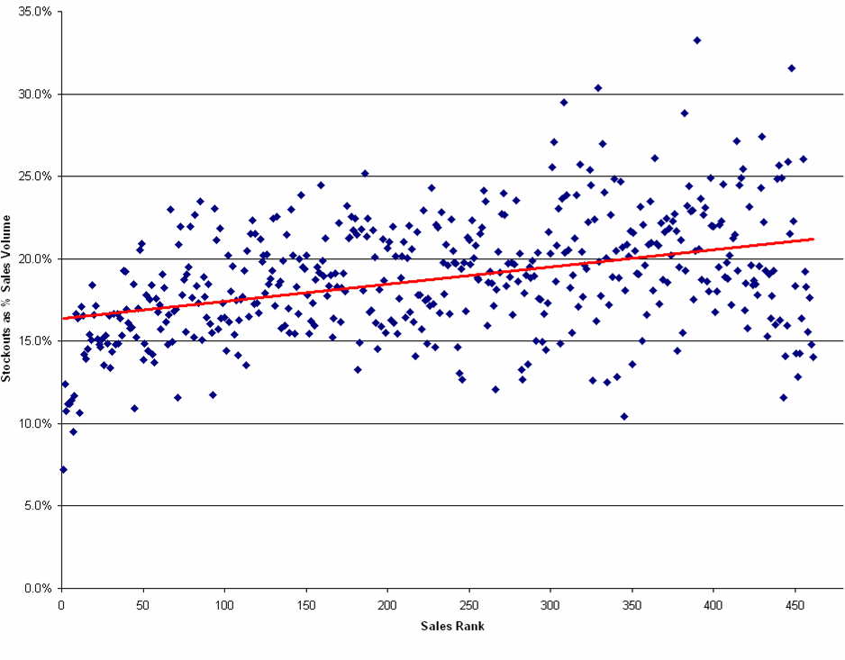
Where the Lost Sales Prize Lies - Store
1
2
3
4
5
6
7
1
2
3
4
5
6
7
Availability
Observations & Findings
Overview
Findings
Evidence suggests the largest stores have the lowest percentage of stockouts. These stores have the highest cover levels
There is a marked decline in the quality of availability at medium and small stores. There is a rich seam of potential lost sales around stores ranked 50 - 300
Lost sales opportunities in small stores vary greatly. This is reflective of the fact that stock is extremely slow moving. Consequently, demand is extremely difficult to forecast, and there is no real depth of stock cover
Measurement
Replenishment
Store Deliveries
Book Stock
Range
Complexity
Margin
Erosion
Large stores have the
lowest % of stockouts
There is less of a business impact of stockouts in small stores
Medium to large stores are where the largest potential prize lies

Slide 45
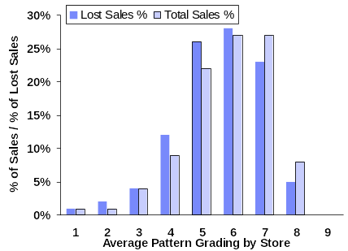
Where the Lost Sales Prize Lies - Pattern
1
2
3
4
5
6
7
1
2
3
4
5
6
7
Availability
Observations & Findings
Overview
Findings
IBM analysed stockouts based on the grading given to stores by within each RG3
The assertion made previously on greatest lost sales opportunity being in the middle to large stores is enforced by analysis by pattern
Stores with an average pattern grade of 4 – 6 account for 58% of sales, yet contribute to 66% of all retail stockouts
Conversely, the small stores (7 – 9), where patterns are normally 1’s or 2’s, and therefore would potentially be at higher risk of stockouts account for just 28% against a sales contribution of 36%
Measurement
Replenishment
Store Deliveries
Book Stock
Range
Complexity
Margin
Erosion
Patterns qualify the ‘store size’ availability hypothesis
Grades 4 – 6 suffer greatest
frequency of stockouts
There again appears little opportunity around small stores

Slide 46
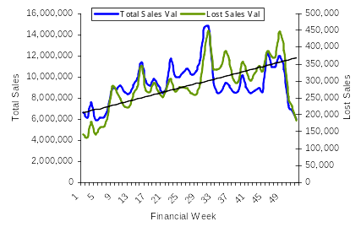
Where the Lost Sales Prize Lies - Phasing
1
2
3
4
5
6
7
1
2
3
4
5
6
7
Availability
Observations & Findings
Overview
Findings
The first half of the year (05 / 06) sees lost sales trending in line with total sales
During the stock build for ‘back to school’ and for AW 05, the level of stockouts diminishes. This reflects the initial stock push providing depth across sizes
Coming out of back to school, there is a disproportionately high level of stockouts which continues into the Christmas trading period
This increased level of stockouts is further compounded by the fact that much of the lost sales during this period would have been full-price sales
The lost sales for AW05 may be explained by the migration to Westway, although this should be further investigated
Measurement
Replenishment
Store Deliveries
Book Stock
SS ‘05
AW ‘05
Range
Complexity
Margin
Erosion
High sales does not necessarily translate into availability issues
Stock build in stores does drive improved availability performance
A significant increase in lost sales was experienced for much of AW05

Slide 47
Causes of Poor Availability
1
2
3
4
5
6
7
1
2
3
4
5
6
7
Availability
Observations & Findings
Overview
General Findings
Measurement
IBM recognises the complexity of the Clarks business model, where the typical rate of sale for a SKU is around 0.04 units per store/week
Culturally, there is a sense that the current status quo is an unavoidable characteristic for a business with such slow moving stock. This apparent feeling perpetuates the lack of urgency and desire in driving availability and minimising the impact of lost sales
This approach manifests itself throughout the organisation from merchandising through logistics and into store operations
We are informed that there are currently no high-profile initiatives under way within the organisation to drive an improvement in store availability
Much of the business data is available to analyse product and store trends to support more intuitive decision making however it is not being used to date
The management of inventory from supplier order through to customer purchase is characterised by a ‘one-size fits all’ approach
There is a general lack of importance attached to the relative costs of non-availability and the true net margins achieved by different store-SKU combinations
Replenishment
Store Deliveries
Book Stock
Range
Complexity
Margin
Erosion
The business rate of sale at SKU-level is extremely slow
All business functions are impacting availability to an extent
A one-size fits all approach characterises the e2e supply chain

Slide 48
Causes of Poor Availability - Measurement
1
2
3
4
5
6
7
1
2
3
4
5
6
7
Availability
Observations & Findings
Overview
Measurement
Findings
Management Attention
At-store availability currently does not have the profile it warrants within the Clarks organisation. There is apparently no single accountable person at board-level driving availability
We are informed that there are currently no high-profile initiatives underway to improve at-store availability
A high-level business measure for availability has been defined, but not implemented
Stores are unaware of the potential role they can play in improving availability
Other business functions are incentivised around costs which can have a counter-productive effect on availability
Without availability being a key theme on each business function’s agenda, and without robust measures underpinning performance, it will be extremely difficult for Clarks to realise the >£20m lost sales opportunities
Measurement
Replenishment
In-Store Execution
Replenishment
Inventory Accuracy
Promotions Management
Store Deliveries
Ordering Systems
Source: ECR – 7 Levers of Availability
Book Stock
Leading Practice
Range
Complexity
Grocers are leading the way in defining robust availability measures
Speciality apparel and dept stores drive availability hard especially promotions, Seasonal events
These successful retailers drive for 100% availability of stock at these events etc and for core – non seasonal/fashion lines all year
Margin
Erosion
Availability is not seen as a key business measure
Although a measure exists, it does not drive performance / behaviour
No individual at a senior level is accountable for driving availability

Slide 49
Causes of Poor Availability - Measurement
1
2
3
4
5
6
7
1
2
3
4
5
6
7
Availability
Observations & Findings
Overview
Recommendations
A robust KPI and data capture method for at-store availability must be defined against which the success of all agreed initiatives can be measured
This measure should be more than a centralised statistical measure, and thus stores must play a key role in the process. This should include benchmarking across genders, RG3s, store formats etc.
Ownership of the measure is critical: Clarks should ensure clarity over who is Responsible, Accountable, Consulted and Informed. This is particularly important as several functional areas each own part of the process
Performance on availability should form an integral part of business reporting, e.g. weekly sales meetings
Availability performance against the business-agreed measure should be a driver for action. This could be done in the short term for events and promotions until the SAP BW is in place
There is currently no plan or capability to develop a robust availability measure within Fusion, however, SAP BW will offer Clarks the flexibility to deliver measurement and reporting functionality once requirements are defined
1
Measurement
Replenishment
Store Deliveries
Book Stock
Implementation Challenges
People
Process
Technology
Financial
3rd Parties
Range
Complexity
1
Margin
Erosion
A robust measure is the first priority for improving availability
The profile of availability must be raised across business functions
Availability needs to have clear ownership at a senior level

Slide 50
Causes of Poor Availability – Replenishment Mechanism
1
2
3
4
5
6
7
1
2
3
4
5
6
7
Availability
Observations & Findings
Overview
Findings
The process for stock allocation is based solely on the grading system - a sell-one, deliver-one replenishment mechanism
For example, if a store has a pattern of 2 units, and each time it receives a replenishment, it sells through within 48 hours, the replenishment model will continue to replenish 2 units, and does not intuitively see the potential to minimise risk of stockouts by increasing the cover level
This approach is far too simple for a solely systems-based replenishment model
The impact of this model is that any potential for stores or styles to outperform their grade is severely constrained, and potential sales will never be identified or realised
Products are managed centrally at a global level, focusing at gender, RG3 and style level. Merchandising teams do not have the tools to delve deeper through exception reporting, resulting in insights into sales opportunities remaining untapped
Measurement
Replenishment
Store Deliveries
Book Stock
Leading Practice
Range
Complexity
Many leading retailers use systems with complex algorithms to calculate potential demand opportunities, providing a dynamic allocation, proactively maximising sales. This approach is not confined to fast-moving grocery
Retailers will also use alerting mechanisms to analyse trends and proactively identify potential availability issues. This enables the central teams to manage by exception
Margin
Erosion
Replenishment is based on a sell-one, deliver-one principle
The system does not proactively look for sales opportunities
Too many processes are manual and managed at a global level

Slide 51
Causes of Poor Availability – Store Patterns (Cover Levels)
1
2
3
4
5
6
7
1
2
3
4
5
6
7
Availability
Observations & Findings
Overview
Findings
There appears to be a generally risk averse approach to backing lines and / or stores to really drive sales. The impact of this appears to be more acute in the medium-large stores where analysis indicates most of the stockouts occur
Merchandising decisions around stock cover are generally taken at aggregated grade level. Some manual processes exist to identify sales patterns within grades, but the sheer scale of store-SKU combinations make it impractical to identify and react to potential availability issues
The business perceives its products as a slow-moving, and consequently manages all SKUs in the same manner
There is some degree of flex for stores to move between grades, but the grading process is based largely on previous sales history, which by nature is characterised by lost sales opportunities. The whole model therefore becomes self-perpetuating, preventing store patterns moving easily as demand fluctuates
Measurement
Replenishment
Store Deliveries
Book Stock
Leading Practice
Range
Complexity
In a high-SKU, slow-moving environment it is important to segment the SKU range to identify and back the lines with high reward for availability and lowest risk of margin erosion from overstocks
Retailers use powerful analytics to provide differentiated service levels and maximise sales and margin by segmenting products on areas such as rate of sale, risk level and lifecycle
Margin
Erosion
Merchandisers are not given sufficient decision support tools
Al SKUs are managed in the same manner, regardless of behaviour
Grading is not predictive, being based on sales history

Slide 52
Causes of Poor Availability –
Replenishment Mechanism & Cover Levels
1
2
3
4
5
6
7
1
2
3
4
5
6
7
Availability
Observations & Findings
Overview
Recommendations
Clarks needs to develop a more responsive model for replenishing store stocks
An improved system than the current grading process would calculate each store’s potential sales and increase or reduce cover levels accordingly. Replenishment rules would be continually reviewed throughout the lifecycle of the product.
The business needs to better understand product behaviour through improved Business Intelligence. Much of this information is or will be readily available, but needs to be harnessed to understand the way products are managed through their entire lifecycle
Short-term fixes need to be investigated to improve replenishment. This should include continuous review of patterns in light of the new availability measure (Recommendation 1)
Clarks also needs to leverage the best-practice processes developed in Children’s, and roll-out to other genders as a priority. Improvement teams should be developed to continue defining best-practice from an availability perspective
Clarks will be able to define SKU-level target stocks to replace the broad pattern system currently in place. The benefit of this change can only be leveraged by enabling merchandisers and allocaters to manage by exception
Grading will be done at sub-BMC (consumer type level) in Fusion and the number of grades will increase from 10 to 20
2
Measurement
Replenishment
Store Deliveries
3
Book Stock
Implementation Challenges
People
Process
Technology
Financial
3rd Parties
Range
Complexity
2
3
4
4
Margin
Erosion
Short-term fixes, e.g. best-practice definition are imperatives
The case for a new replenishment system should be investigated
Product segmentation based on characteristics/behaviour is critical

Slide 53
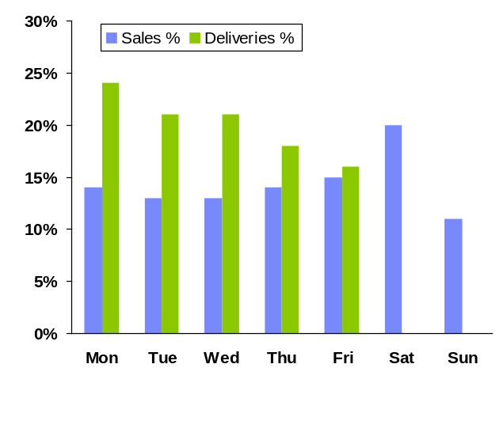
Causes of Poor Availability – Replenishment Profile
1
2
3
4
5
6
7
1
2
3
4
5
6
7
Availability
Observations & Findings
Overview
Findings
The Street Distribution Centre and Carrier Network are structured to provide 5-day store deliveries. Much of the retail estate now trades for 7 days, increasing the likelihood of stockouts on Saturdays and Sundays
Replenishment volume is generated entirely from polled sales; there is no stock build to meet potential weekend sales. For faster moving lines, this diminishes the ability to maximise sales
The ‘order well’ from which wholesale, retail and franchise orders are pulled does not support the urgency of retail orders. Store replenishments are 2nd (of 5) priority levels. During peak activity, it has not all replenishment orders may be selected for pick on the planned day, increasing the time a store will trade without that style. There is no KPI in place to measure the scale of impact on retail
Franchisees, contractually have been a higher allocation priority than retail, although this is due for imminent change
The importance of replenishment is based on a store’s fixed ranking (ranked 1 – 99). Prioritisation does not reflect the dynamic needs of each store’s stock. Consequently, the store whose need is greatest will not necessarily be served
Leading Practice
Delivery Profile
Measurement
Replenishment
Store Deliveries
Book Stock
Leading Practice
Range
Complexity
Leading practice would involve aligning store deliveries to projected demand patterns. Retailers will forecast demand and build store stock levels to reflect this
A differentiated service-level will exist for those SKU-store combinations for which the retailer wishes to maximise availability. This would potentially consist of more frequent deliveries and reduced replenishment lead-times
Margin
Erosion
5-day deliveries to stores compromise availability
There is no stock build of potential ‘hot styles’ for peak trading days
‘Order well’ prioritisation can cause replenishment delays

Slide 54
Causes of Poor Availability – Replenishment Lead Times
1
2
3
4
5
6
7
1
2
3
4
5
6
7
Availability
Observations & Findings
Overview
Sale Day | Store Delivery | Available to Sell
Monday | 2pm Wed | Thursday
Tuesday | 2pm Thu | Friday
Wednesday | 2pm Fri | Saturday
Thursday | 2pm Mon | Tuesday
Friday | 2pm Mon | Tuesday
Saturday | 2pm Tue | Wednesday
Sunday | 2pm Tue | Wednesday
Findings
The lead-time is viewed by the business as being Day 1 for Day 2. In reality, the service level is significantly lower than this. The Monday - Friday delivery profile ensures that although store sales are frequently polled, the Sale to Replenishment lead-time can take up to 5 days
Coupled with the low store cover levels, this significantly increases the chance of a lost sale. For example, if a store sells a shoe on Thursday, it is likely that the store will trade through Friday, Saturday and Sunday with non-availability on that particular SKU
All stores and styles work to the same replenishment lead-time. There is no differentiated offer to support key stores / styles
Without the ability to accelerate the replenishment of certain styles or stores, it is extremely difficult to improve stores stock availability, particularly around the weekend trading period
Measurement
Replenishment
Store Deliveries
Book Stock
Leading Practice
Range
Complexity
Many retailers favour a centralised stockholding model with rapid response to store demand. This avoids the need for a ‘push’ replenishment, maximising the opportunity for full price sales and reducing the risk of ‘lifecycle distress’ of store stock
Stores receive stock 6 and 7 days a week to meet demand; they also build stock levels with late deliveries for peaks periods
Margin
Erosion
Replenishment lead-times
are too long
Low cover levels and 5-day deliveries increase availability risk
There is no segmentation of service level by store needs

Slide 55
Causes of Poor Availability – Replenishment Profile & Lead Times
1
2
3
4
5
6
7
1
2
3
4
5
6
7
Availability
Observations & Findings
Overview
Recommendations
Whilst large scale changes to replenishment profiles would derive insufficient benefit, Clarks should trial reduced replenishment lead-times and increased frequency on carefully selected store-SKU combinations. 6 or 7 day supply chain operations should be considered. Cost and workload implications for logistics should be carefully considered
Clarks should also consider investing in a model to shape future service levels, segmenting and differentiating store replenishment based on a variety of factors such as demand volatility, store trading patterns,
Where an opportunity is identified through a robust availability measure and segmentation, IBM believes there is an opportunity to poll sales for certain store-SKU combinations early Friday pm with a view to executing deliveries pre-opening Saturday. This will maximise availability and thus sales for weekend trading, and could be rolled out to other days
See Recommendation 14 on page 59. A KPI should be implemented to measure the level of replenishment for retail that does not get pulled for pick on its planned day
Development of any form of differentiated lead-times or replenishment profiles is out-of-scope for this phase of Fusion
Early polling of sales data could potentially be achieved, but further investigation would be required to understand the implications on SAP and EPoS systems
5
Measurement
Replenishment
Store Deliveries
6
Book Stock
Implementation Challenges
7
People
Process
Technology
Financial
3rd Parties
Range
Complexity
5
6
7
Margin
Erosion
14
Speed of replenishment must be increased for certain store-SKUs
Delivery frequency must be improved for certain store-SKUs
Targeted early polling provides new availability opportunities

Slide 56
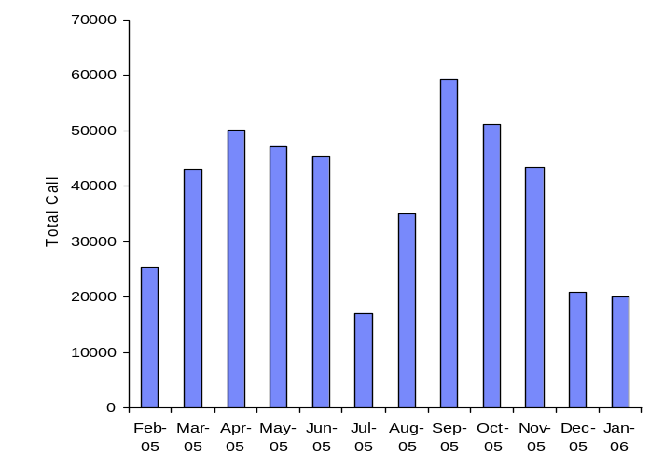
Causes of Poor Availability – Customer Order Execution
1
2
3
4
5
6
7
1
2
3
4
5
6
7
Availability
Observations & Findings
Overview
Findings
The Clarks Customer Order process currently does not align with the Clarks ‘customer-service’ orientated offering
Where a customer requires a style that is out-of-stock at store, a ‘Special Order’ is placed through the telesales team, and sent to the Distribution Centre for delivery to store
The typical lead-time from order to delivery is 8 – 10 days. The lead-time is significantly longer than the industry average, resulting in customer dissatisfaction and potential lost sales
Upon delivery at store, the only means of identification that this is a customer order, is a small flag on the packing note. The process of proactively contacting the customer and managing the order through to completion is too reliant on human intervention
With such an ad hoc process, there is a high likelihood of the customer not returning to complete the sale
Measurement
Replenishment
Store Deliveries
Book Stock
Leading Practice
Range
Complexity
Customer expectation on service levels has been fuelled by retailers with integrated multi-channel offers
A number of Clarks key competitors currently allow customer orders to be taken in store (with full visibility of DC stock – no phone calls)
For most items, customer expectation is for order fulfilment to be achieved within 48 – 72 hours
Margin
Erosion
The lead-time for delivery is extremely uncompetitive
The process for expediting orders is not customer focused
Sales are being lost through a non-customer focused offering

Slide 57
Causes of Poor Availability – Customer Order Execution
1
2
3
4
5
6
7
1
2
3
4
5
6
7
Availability
Observations & Findings
Overview
Recommendations
The process for capturing a sale when the customer cannot be satisfied from store stock requires a major review and design
IBM believes fulfilment should be achieved within a maximum of 72 hours of order placement subject to DC stock
The capturing of non-availability will help the store to rectify their stock issue. Clarks should look to current telesales information to understand what availability insights it can provide
Processes for managing customer relationship throughout the life of the order must be revised and standardised
The customer should have the option of having their Special Order delivered to a home address for a small surcharge, leveraging the relationships with existing carriers where possible. This concept should fit with the development of Clarks multi-channel offer
Development of any CRM tools is out-of-scope for this phase of Fusion. It is planned that the current Customer Order execution processes will remain as current state
Measurement
8
Replenishment
Store Deliveries
9
Book Stock
Implementation Challenges
10
People
Process
Technology
Financial
3rd Parties
Range
Complexity
8
9
10
11
Margin
Erosion
11
A lead-time for order to delivery of 72 hours should be agreed
Process definition throughout the order life is critical
Customer order execution will increase sales and repeat business

Slide 58
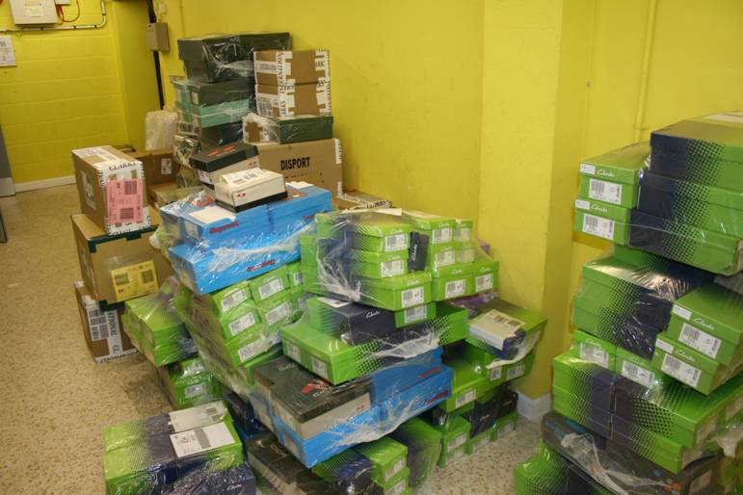
Causes of Poor Availability – Logistics Store Service
1
2
3
4
5
6
7
1
2
3
4
5
6
7
Availability
Observations & Findings
Overview
Findings
All stock is delivered through the carrier network, irrespective of drop-size. Delivery times vary from pre-opening to mid-afternoon, and are dictated by location of Clarks stores in carriers’ shared-user delivery schedule. These can vary from day-to-day. All stores have the same agreed service level
This ‘one-size fits all’ approach does not reflect the individual needs of stores, typically dictated by trading profiles, drop sizes, labour constraints etc, all of which compromise stores’ ability to minimise risk of lost sales
Vehicle planning for trunking into carriers’ hubs is managed in an ad hoc fashion. This can lead to overspill into the following day of as much as 3 – 4,000 pairs, resulting in stores trading a further day without stock
Stores do not have any forward visibility of expected deliveries, and are therefore unable to advise a customer when an out-of-stock is due for replenishment. A potential sale is therefore lost
This lack of visibility can, where volumes are high, delay stock putaway, as can the configuration of stock presentation. Sales staff’s ability to fulfil a customer’s requirements are therefore compromised
Measurement
Replenishment
Store Deliveries
Book Stock
Leading Practice
Range
Complexity
Many retailers recognise the impact of the ‘last 50 yards’, and optimise their supply chain around store service levels
This optimisation often takes the form of data flows to store, pre-opening deliveries, store friendly packaging & segregation,
Margin
Erosion
The logistics operation is geared towards cost optimisation
The ‘one-size fits all’ model does not recognise store specific needs
Store availability is compromised by current service model

Slide 59
Causes of Poor Availability – Logistics Store Service
1
2
3
4
5
6
7
1
2
3
4
5
6
7
Availability
Observations & Findings
Overview
Recommendations
The differentiated service model recommended under ‘Replenishment Mechanism & Cover Levels’ should bring into scope the timing of store deliveries with a view to applying pre-opening deliveries where beneficial
Clarks should consider the opportunity to look into direct store deliveries to large and clustered stores. This would allow certain store deliveries to be brought forward to the previous evening, particularly around weekend trading
A set of retail-focused KPIs should be developed to measure logistics impact on availability. Measures should include quantifying the level of stock carried over due to insufficient space on carriers’ trunk vehicles and total replenishment stock not pulled from the order well due to pick capacity constraints
A file should be made available for each store on the Stores Intranet showing allocated stock by SKU. The status should be updated when the stock is confirmed as despatched from the DC
SAP will spilt pick tickets by department. This will potentially provide the ability to pick, pack and despatch goods by department
Stock in transit information will be available for stores on the intranet allowing space and labour planning for expected deliveries from the DC
12
Measurement
Replenishment
13
Store Deliveries
Book Stock
14
Implementation Challenges
People
Process
Technology
Financial
3rd Parties
Range
Complexity
12
13
14
15
Margin
Erosion
15
Timings of store deliveries must be aligned to needs
Opportunities to reduce logistics lead-times should be investigated
Forward visibility of deliveries improves customer management

Slide 60
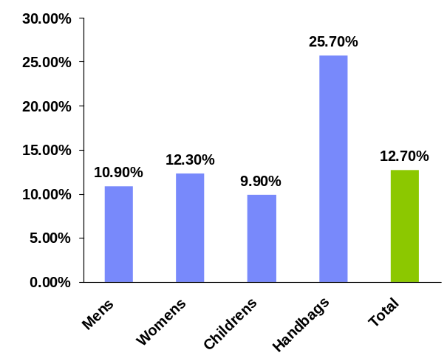
Causes of Poor Availability – Store Book-Stock Accuracy
1
2
3
4
5
6
7
1
2
3
4
5
6
7
Availability
Observations & Findings
Store Stocktake:
Gross Book Stock Variance
Findings
Overview
The gross book stock variance of the all-store stocktake for 2005 is significantly higher than would typically be expected, averaging 12.7%. This figure includes some notably large variances including high turnover stores such as Metro Centre (34.4% variance) and Oxford Circus (39.5%)
The Net Variance for Clarks stores is -0.1%, indicating that the gross variance is not a shrinkage issue
Book stock accuracy is a key driver for availability. Where the stock file shows stock, but there is no corresponding physical stock, the system will not replenish, and the store will lose potential sales
Stores do not have the tools to conduct any sort of rolling counts or focus counts to rectify any book stock errors, potentially resulting in a store repeatedly losing sales
Measurement
Replenishment
Store Deliveries
Book Stock
Leading Practice
Range
Complexity
Book stock accuracy is viewed by many retailers as being a key measure and cornerstone of store availability
This assertion is even more prevalent for retailers whose replenishment is calculated directly from their store book stocks
Margin
Erosion
Gross book stock variance is too high across the business
Book stock accuracy has a direct effect on replenishment accuracy
Stores do not have the ability to maintain stock accuracy

Slide 61
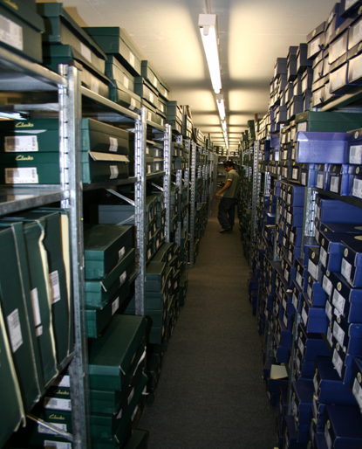
Causes of Poor Availability – Store Book-Stock Visibility
1
2
3
4
5
6
7
1
2
3
4
5
6
7
Availability
Observations & Findings
Overview
Findings
Stores do not have any form of visibility of their book stock positions, and have no reporting tools to enable them to manage potential book stock variances by exception (e.g. stock no sales reports). This causes a lack of ownership of stock accuracy and its subsequent impact on availability
Stores cannot accurately provide customers with a true picture of stock. There is no referencing to systems when checking stock availability as staff view is largely based on line-of-sight information. There is a heavy reliance on stockroom management processes in fulfilling customer needs. The impact of these manual processes is potential lost sales where stock was physically ‘available’ in store
Stores do not perform any data capture to identify the fact that a customer has requested a SKU that cannot be provided. Consequently there is no process to rectify the problem at a local level or analyse the scale of an issue at a business level
There is no visibility for stores of stock availability at stores in the surrounding area. This provides little opportunity to proactively fulfil the customer’s needs
Measurement
Replenishment
Store Deliveries
Book Stock
Leading Practice
Range
Complexity
Store Managers are given real-time stock visibility, and exception reports to perform focus counts on variant SKU trading patterns
The deployment of PDAs and next generation EPoS terminals in store enables significantly improved order fulfilment and customer management
Margin
Erosion
Stores have no visibility or control over their stock files
Staff and customers do not have a clear picture of available stock
Stores cannot proactively check local stores or DC stock

Slide 62
Causes of Poor Availability –
Store Book-Stock Accuracy & Visibility
1
2
3
4
5
6
7
1
2
3
4
5
6
7
Availability
Observations & Findings
Overview
Recommendations
It is critical in managing the store-controllable factors of availability to give visibility and control of book stock to store colleagues. There are several opportunities to consider here:
  Exception reporting to focus stock checks on lines where unusual patterns occur
  The ability to interrogate the system on an ad hoc basis to check SKU availability
  A process to ensure all stores conduct a specified number of cycle counts / focus counts per week
  A standard process for capturing and following up ‘lost sales’ where the customer does not buy due to non-availability
Stores must also be given the tools to proactively search stock data. To be able to search local stores and have direct visibility of DC stock would significantly improve the customer experience
Further investigation needs to be conducted into the causes of gross variance. The profile needs to be raised on its importance, and improvement plans developed for poor performance in stores / Distribution Centre
Stock takes interfaced into SAP will provide an opportunity to analyse pattern of variances using historical data along with financial valuations
Carrier claims process will allow monitoring of any delays in updates to store receipts and highlighting stocks lost in transit
Central Stock Audit Team @ HQ has a number of bespoke reports to effectively support the Retail claims process
16
Measurement
Replenishment
Store Deliveries
Book Stock
Implementation Challenges
17
People
Process
Technology
Financial
3rd Parties
Range
Complexity
16
17
18
Margin
Erosion
18
Stores need the tools to manage book stock and availability
Business-wide stock visibility can aid customer fulfilment
Investigation and resolution of book stock variance is critical

Slide 63
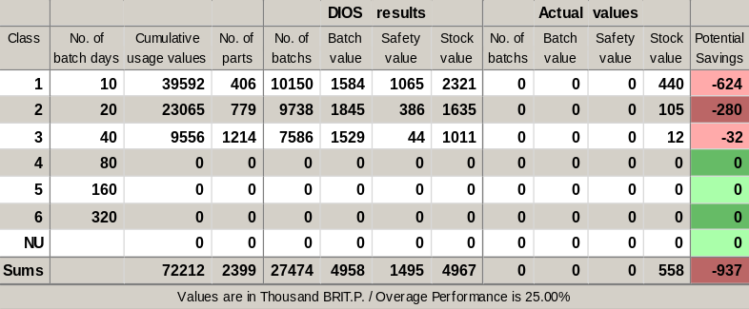
Causes of Poor Availability – Range Complexity
1
2
3
4
5
6
7
1
2
3
4
5
6
7
Availability
Observations & Findings
Overview
Findings
IBM’s DIOS inventory optimisation tool was used to give a high-level assessment of Clarks central stockholding. Stock is classified based on rate of sale, then optimal inventory levels are determined based on demand profiles. This enables identification of stock underages (potential lost sales) as well as excess inventory
Lost sales opportunity due to upstream supply are conservatively estimated at between £2.5m and £4.0m. Much of the lost opportunity appears to lie within the faster moving lines, indicating an inability to react to ‘hot styles’
70% of stock is received into the business at the start of the season before a pair has been sold. The length of supply lead-time makes it very difficult to react where forecasts are inaccurate. This has a direct impact on availability and margin, and currently compromises Clarks ability to reduce working capital
The breadth of SKU range is a further complexity. Several examples exist where stores are only able to display 80% of products for which they are ranged, raising the potential risk of lost sales
Measurement
Replenishment
Store Deliveries
Potential lost sales due to non-availability
of replenishment stock in DC occurs
Most frequently in fastest sellers
Book Stock
Range
Complexity
Leading Practice
Margin
Erosion
The Zara model is generally held up as an example for supply chain responsiveness, where supply is kept close to demand, the value of sales data is maximised, early buying commitments are minimised and the focus is very much on maximising full-price sales
Sales are being lost due to the current supply chain model
The supply chain is unable to react to un-forecasted demand
Stores struggle to display and manage the number of styles

Slide 64
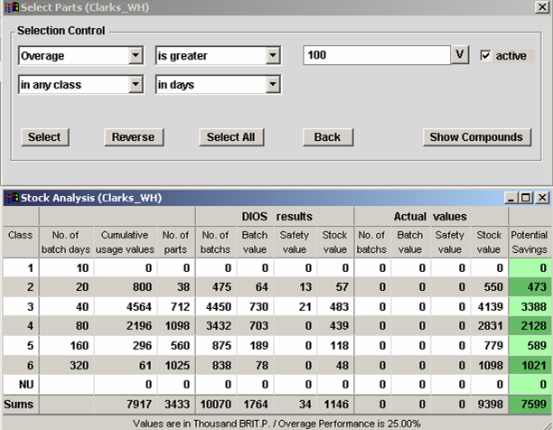
Causes of Poor Availability – Range Complexity
1
2
3
4
5
6
7
1
2
3
4
5
6
7
Availability
Observations & Findings
Overview
Findings
The IBM DIOS model indicates a potential inventory reduction opportunity in the Clarks Distribution Centre of around (£10 - £15m)
Included in this figure appears £5.7m of stock in the DC with no sales during the last 12 months. This will be a mix of lines awaiting introduction and lifecycle distressed stock
There is a further £7.6m of excess inventory where there is greater than 100 days stock cover in the Distribution Centre. The total excess stock for these SKUs may be greater as this figure does not take into account store stock positions
Although it would be difficult to realise the full £13.3m benefit from DC stock alone, IBM believes that a potentially significant inventory reduction opportunity also exists in store
With a further £40m of total inventory to analyse in stores, IBM believes a business-wide reduction of £10m - £20m is certainly achievable
Store and DC inventory requires further analysis to understand how this working capital can be released and determine causes to minimise future excess inventory
Measurement
Replenishment
Store Deliveries
Book Stock
Range
Complexity
Margin
Erosion
Total potential saving of £7.6m from SKUs
with over 100 days inventory cover
There is a potentially high
level of obsolete stock
A significant level of
overstocks exist in the DC
Overstocks and obsolescence require an urgent business review

Slide 65
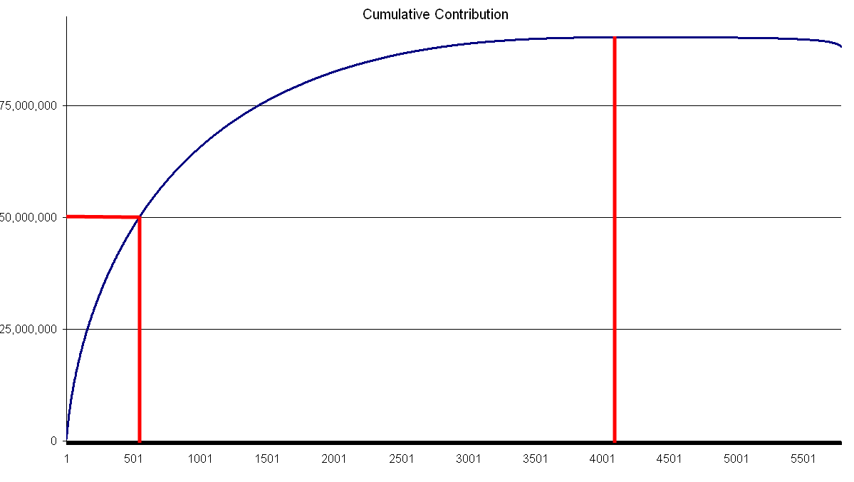
Causes of Poor Availability – Margin Erosion
1
2
3
4
5
6
7
1
2
3
4
5
6
7
Availability
Observations & Findings
Overview
Findings
1,611 styles
returning a negative
net margin
The risk averse nature of the replenishment model leaves Clarks with significant central stockholding towards the end of the season. This leads to significant deep discounting (all channels) to ensure sell through is achieved
Taking into account branch expenses, logistics costs and retail central overheads (but excluding unallocated central costs), 28% of all styles sold returned a negative net margin. These styles account for just 5% of total sales revenue but 9% of cost of goods sold
Conversely, the top 300 styles (5% of total range) account for some 41% of net profit and 30% of sales
These figures may indicate a lack of control over product-level profitability, and also a lack of margin management responsibility – particularly in the design and buying functional areas
By gaining control of net margin, Clarks could expect to realise £2m - £3m of incremental profit just by ensuring all lines return a minimum zero net margin
Measurement
Replenishment
541 styles returning
£50m net profit
Store Deliveries
Book Stock
Leading Practice
Range
Complexity
Many retailers are now employing advanced price optimisation models, enabling full-price, promotional and end-of-season markdown prices to be set to optimise profitability
Retailers also look at cost-to-serve modelling to understand the total cost of sales by individual style or SKU. This supports decision making around sourcing, buying and store replenishment
Margin
Erosion
Profit is chiefly driven by a small percentage of the range
There is a huge ‘tail’ which often returns negative margins
There appears little control or ownership over lifecycle margins

Slide 66
Causes of Poor Availability – Range Complexity & Margin Erosion
1
2
3
4
5
6
7
1
2
3
4
5
6
7
Availability
Observations & Findings
Overview
Recommendations
Quantify the level of lifecycle distressed stock within the Clarks business (stock but zero sales). Work to understand potential causes and identify opportunities to clear
Develop a clear understanding of true net profitability of each individual style throughout its lifecycle. This model should become a key support tool for future ranging, pricing and inventory decisions
Identify opportunities to rationalise the SKU range to drive a more profitable business Use the cost-to-serve model as an input to challenge the current thinking
Develop a strategy for a more robust and responsive upstream supply chain. Key initiatives to consider may include production and transit lead-time reductions, dual sourcing, increased seasonality,
In WSSR Report, ‘Cover’ and ‘Sales’ key figure should indicate slow moving stock. Further, more specific reports may be designed for future Fusion releases
‘Supply Chain Pipeline Report’ will provide visibility of potential stockouts, enabling Clarks to react as necessary
19
Measurement
Replenishment
20
Store Deliveries
Book Stock
21
Implementation Challenges
People
Process
Technology
Financial
3rd Parties
Range
Complexity
19
20
19
20
22
Margin
Erosion
Business must understand product-level profitability
This must be used to support range and supply chain decisions
A more responsive supply chain is a future pre-requisite

Slide 67
1
2
3
4
5
6
7
1
2
3
4
5
6
7
Store Labour
Observations & Findings
Store Costs
Findings & Observations
What opportunities exist to reduce in-store costs through process efficiency gains and secondary supply chain improvements?
1
2
3
4
5
6
7
Executive Summary
Background Scope and Approach
Financial Analysis & Industry Drivers
Availability
Findings & Obser-vations
Store Labour
Findings & Obser-vations
Opportunity Priorities & Roadmap
Prioritised Case for Action

Slide 68
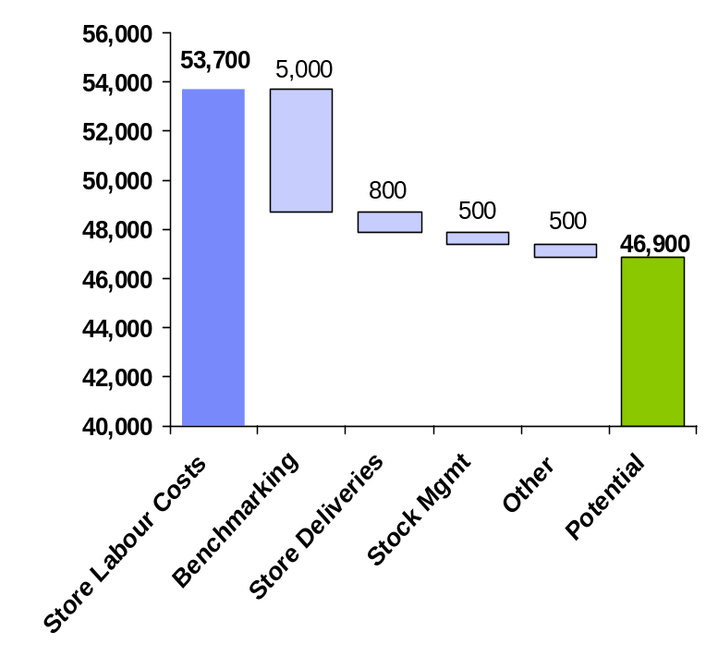
Overview
1
2
3
4
5
6
7
1
2
3
4
5
6
7
Store Labour
Observations & Findings
Overview
High-Level Summary of Findings
£6.8m of identified
potential savings
There are opportunities to review current staffing level in many of the Clarks stores, particularly the higher turnover stores
Through a high-level approach IBM have identified potential savings of up to £5 Million in store labour through internal benchmarking and moving inefficient store closer to the internal best-practice
Store processes have not been reviewed or significantly changed for a number of years. There are definite opportunities to improve some of the key processes
There are opportunities to further reduce labour costs through improving the presentation of store deliveries. This looks to be worth approximately £0.8m
There are opportunities to reduce labour time involved in stock management, through reducing duplication of activities and correcting integrity issues as they are uncovered, by approx £0.5m
Other opportunities include reviewing labour flexibility, labour management tools, staff turnover, stocktakes, the customer order process, customer phone calls and product labelling. These opportunities could be worth a further £0,5m
All opportunities defined must align with any ‘Store Automation’ programme or ‘Store of the Future’ currently being considered by Clarks
Benchmarking
Labour
Flexibility
Labour
Management
Store Stock
Management
Customer
Service

Slide 69
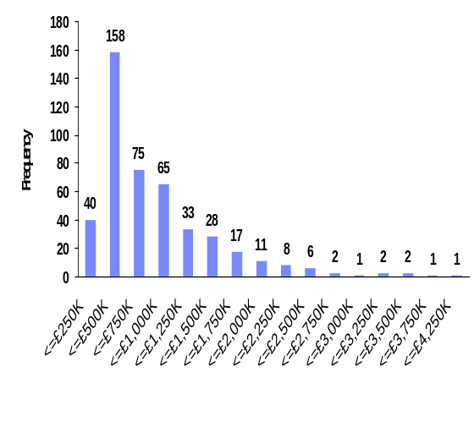
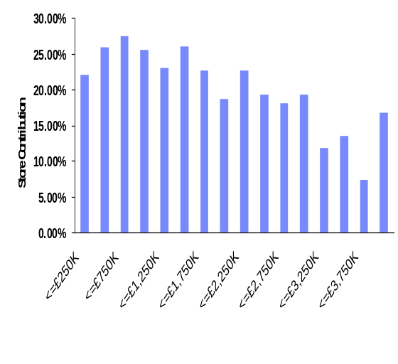
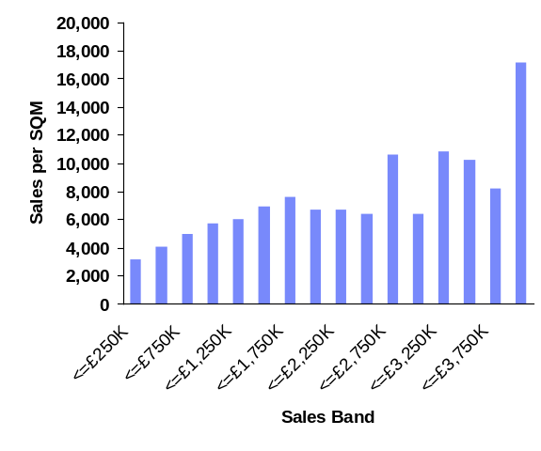
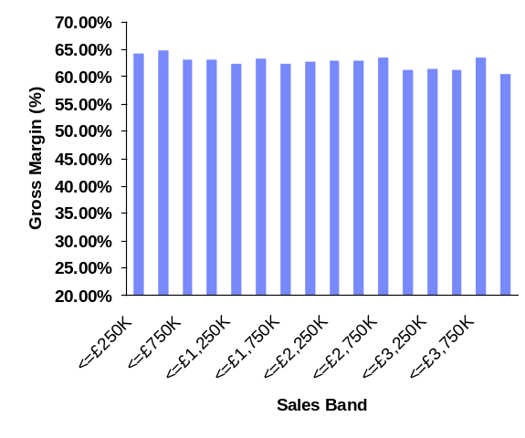
Top Level Store Analysis
1
2
3
4
5
6
7
1
2
3
4
5
6
7
Store Labour
Observations & Findings
Frequency Table: Store Numbers
by Sales Band (£250K)
Store Contribution (% of Sales)
by Sales Band
Overview
Benchmarking
Labour
Flexibility
Labour
Management
Gross Margin
by Sales Band
Store Stock
Management
Sales per SQM
by Sales band
Customer
Service
Clarks has the complexity of a high number of very small stores
Large stores do not achieve greater profitability from their extra volume
There appears to be opportunity to drive existing sales footprint harder

Slide 70
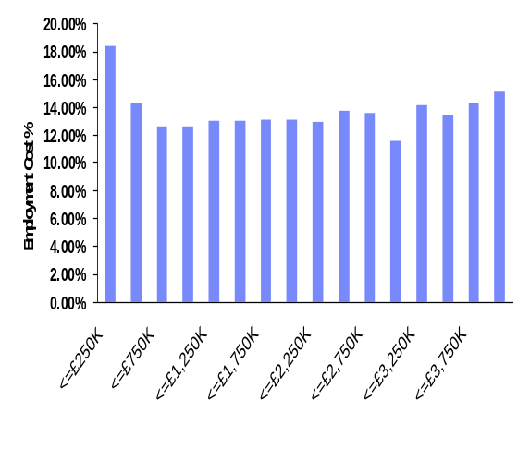
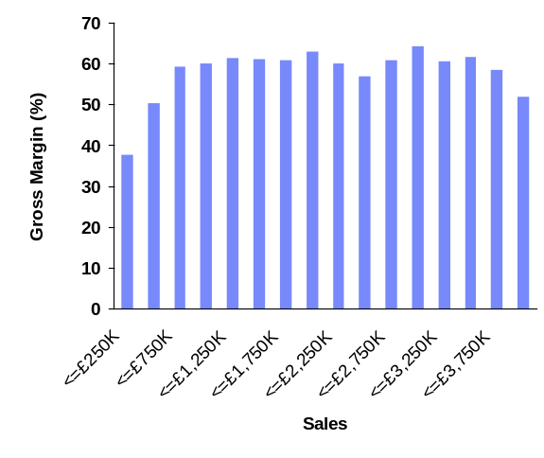
Store Labour Costs - % of Sales
1
2
3
4
5
6
7
1
2
3
4
5
6
7
Store Labour
Observations & Findings
Overview
Store Wages as % of Sales
by Sales Band
Findings
There appears to be no wage improvement as a % of sales in the medium and large turnover stores when compared to the low turnover stores
This is further evidenced when looking from a productivity perspective (sales £ per hour worked). Again, there appears to be no efficiency generated in the medium and large stores
This does not reflect industry leading practice, where larger turnover stores are able to leverage their volumes to reduce their labour-to-sales ratio. Large stores would typically look to reduce below the benchmark by some 10 – 20%
In larger Clarks stores, labour scheduling should be aligned with trading requirements, reducing the level of inefficiency
Higher customer traffic and the ability to distribute fixed (and semi-variable) activities through a larger team should drive significant productivity gains
This presents a clear opportunity for Clarks to investigate further through internal benchmarking, realigning the high turnover stores’ labour targets based on efficiency measure used in the low-mid range stores
Benchmarking
Labour
Flexibility
Labour
Management
Average Sales per Hour Worked
By Sales band
Store Stock
Management
Customer
Service
Larger stores labour % cost of sales is disproportionately high
Large stores are not driving efficiency from their sales volume
Internal benchmarking is necessary to address the issue

Slide 71
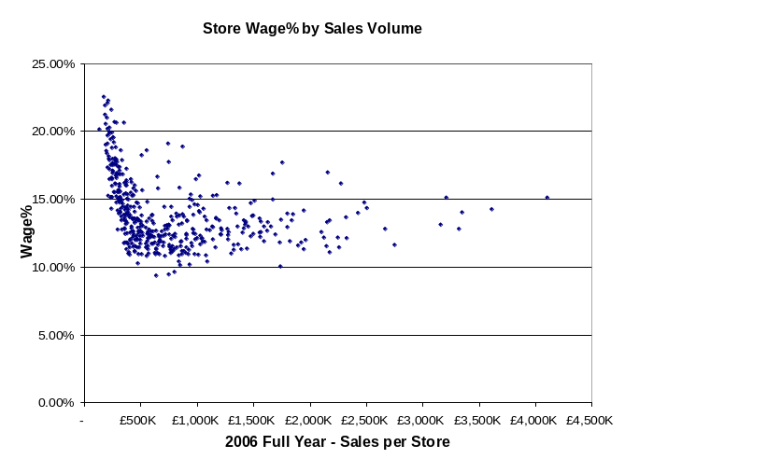
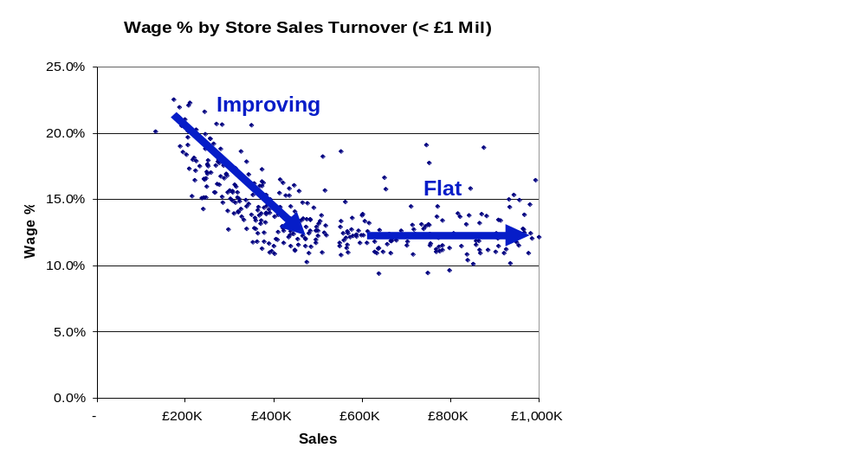
Store Labour Costs - % of Sales
1
2
3
4
5
6
7
1
2
3
4
5
6
7
Store Labour
Observations & Findings
Overview
Labour Cost % of Sales (All Stores)
Findings
Opportunity to reduce
By analysing labour costs as a percentage of sales by store, it is clear to see there is significant variation across all large and medium stores. This indicates a lack of consistency in respect of labour management and little sharing of best-practices
Reducing the sample to just stores with a turnover of less than £ 1 Mil, there is a clear relationship of an improving wage % as turnover increases (as would be expected) in store with a turnover of £500K and less. These stores would naturally have a high fixed labour cost
From £500K turnover stores and higher there is a flat relationship between sales and wages with no improvement in percentage terms beyond the level achieved by the £500K stores.
The lack of improvement factor throughout stores over £500k turnover suggests the opportunity exists to make a material saving in labour costs through benchmarking and internal best-practice sharing
Benchmarking
Labour
Flexibility
Labour
Management
Labour Cost % of Sales (<£1m Sales)
Store Stock
Management
Customer
Service
The best practice for wage % across the Clarks network is basically being driven by the low turnover stores (approx £500K), there is no improvement beyond this level even in larger turnover stores.

Slide 72
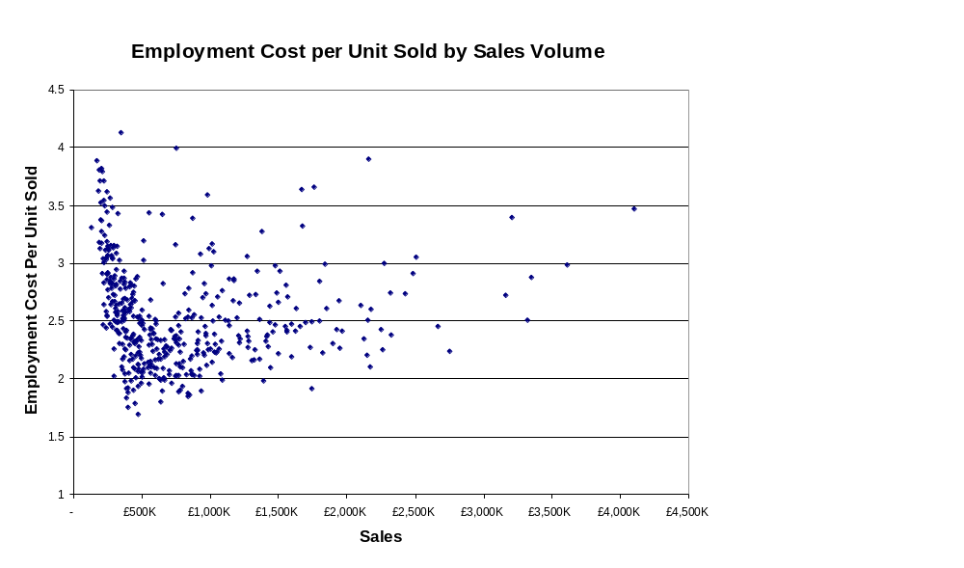
Store Labour Costs – Employment Cost per Pair Sold
1
2
3
4
5
6
7
1
2
3
4
5
6
7
Store Labour
Observations & Findings
Overview
Findings
Benchmarking
Wages as % of sales can in some cases be misleading, so the exercise was repeated using Store Employment Cost per Pair Sold.
Pairs are a better indication of ‘workload’ and therefore should provide a more accurate picture
The overall trend once again shows no leveraging of labour flexibility by the larger turnover stores
Many low turnover stores are operating on a minimum labour level. The trend of seeing productivity improve as sales increase in the smallest stores is consistent
A leading practice store portfolio would expect to see medium and large stores driving far greater productivity levels. A trend which is not currently observable in Clarks retail business
Labour
Flexibility
Opportunity to reduce
Labour
Management
Store Stock
Management
Customer
Service
Using Pairs Sold as a proxy for ‘workload’ shows that the larger turnover stores are operating at a significantly lower level of productivity than the low turnover stores.

Slide 73
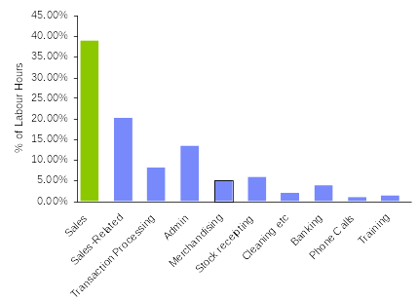
Store Labour Costs – Breakdown by Activity
1
2
3
4
5
6
7
1
2
3
4
5
6
7
Store Labour
Observations & Findings
Overview
Findings
Using the data from the four sample stores, IBM analysed the labour split by store activity
The percentage of labour attributed to non-selling activity appears high for a speciality retailer
Manual administrative processes and stock putaway are two potential improvement areas identified in this review, which contribute a total of over 13% of labour costs
Season changes and promotions are not generally scheduled by stores. These are managed on an exception basis as stores have no planning calendar as such to work from. The breadth of range results in stores spending significant time managing and merchandising stock with a very low rate of sale. Both these factors are not directly accounted for in labour planning, and thus appear to be process inefficiencies
Other areas of note that appear higher than average, are: Managing customer exchanges / refunds and start / end of day processes
Benchmarking
40% of store hours are non-sales related.
This is higher than leading practice and
requires further investigation i.e. Admin, Banking etc
Labour
Flexibility
Labour
Management
Store Stock
Management
Customer
Service
Clarks stores appear to suffer from too high a percentage of non-selling hours
Many of the inefficiencies within the store are symptomatic of upstream causes

Slide 74
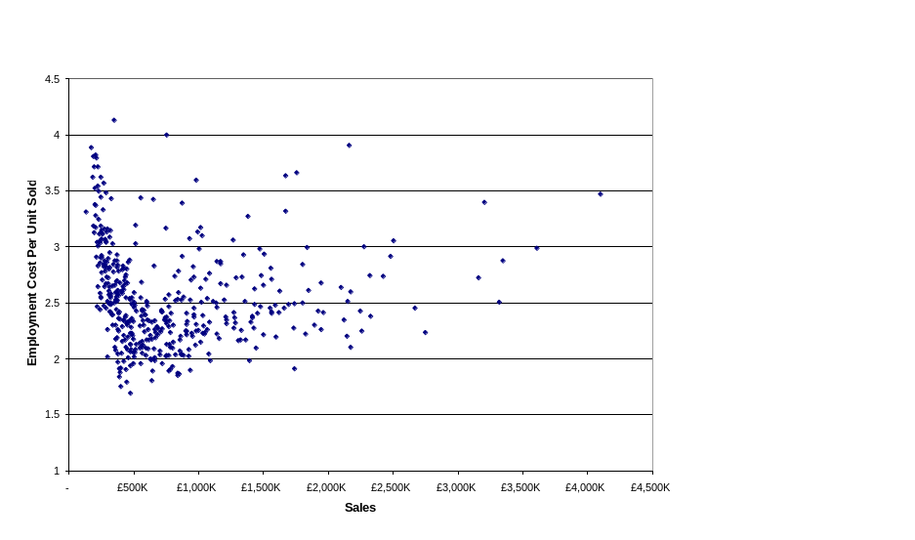
Store Labour Costs – Basic Internal Benchmarking
1
2
3
4
5
6
7
1
2
3
4
5
6
7
Store Labour
Observations & Findings
Overview
Findings
Benchmark Scenario:
Stores > £750K Sales (154 stores) should achieve an employment cost per unit sold of at least the average for the current Top 200 best performing stores (for employment per pair)
Stores > £2 Mil (23 stores) should achieve an employment cost per unit sold of at least the average for the current Top 50 best performing stores (for employment per pair).
No improvement required from stores already beating benchmark.
No improvement required from stores with turnover < £750K as these are assumed to be on minimum manning levels.
Outcome:
Potential total Labour Saving of 10.7% or £5.0Mil. NOTE: Due to physical differences in stores and different customer service levels, achieving 100% of this cost reduction without additional tools will most likely not be possible
Benchmarking
Labour
Flexibility
Labour
Management
Store Stock
Management
Leading Practice
High performing speciality retailers will achieve a store labour % cost of sales of some 2 – 3 percentage points lower than Clarks
Higher turnover stores should achieve higher productivity and better performance in basic labour metrics with Wage % and Employment Cost per Unit.
Retailers will use labour optimisation tools to reduce operating costs identified during the benchmarking period
Customer
Service
Benchmarking indicates a yield of approximately £5.0m per annum
Benefit realised by sharing best-practice across the store base
Some investment would be needed to realise the full £5m prize

Slide 75
Store Labour Costs – Basic Internal Benchmarking
1
2
3
4
5
6
7
1
2
3
4
5
6
7
Store Labour
Observations & Findings
Overview
Recommendations
Perform internal benchmarking on the key labour metrics and realign targets for non-performing stores.
Using the previous scenario benchmarking on Employment Cost Per Pair, the opportunity is as high as £5 Mil.
Running the same benchmark scenario, but using wage % as the metric there is still opportunity of up to £3.3 Mil.
Internal benchmarking provide some “quick wins” and enable much of the benefit to be realised. However, to achieve the full identified cost reduction requires a more detailed labour management programme
Clarks should consider incentivising key individuals such as store and area managers to achieve their benchmarked targets. Such a programme if structured correctly would be self funding
Further steps would involve a more detailed Labour Management Program, utilising the existing Torex data and developing a Store Manager Labour ‘Tool Kit’ for them to better understanding their workload drivers and plan and manage their labour.
The process of internal benchmarking is largely conducted outside of any the ERP system, therefore the benchmarking phase of any Labour Management Programme will be out-of-scope
Clarks should however, consider how SAP BW can potentially support the benchmarking programme through business intelligence
22
Benchmarking
Labour
Flexibility
Labour
Management
Store Stock
Management
Implementation Challenges
23
People
Process
Technology
Financial
3rd Parties
22
Customer
Service
23
Definition of key benchmark metrics is very much the start point
The benchmarking exercise will provide a set of quick wins
A Labour Mgmt Programme is necessary to make a step change

Slide 76
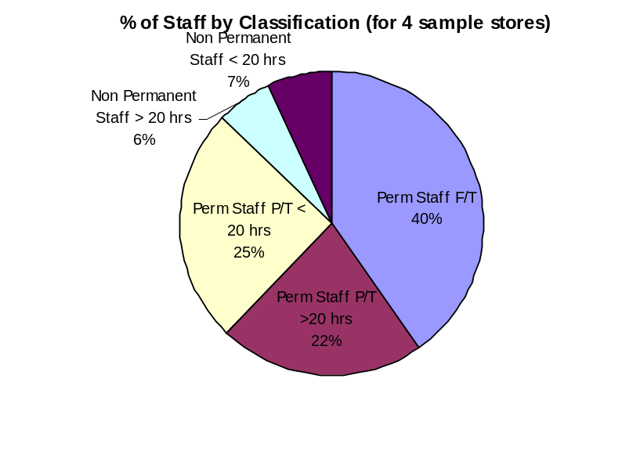
Store Labour Costs – Labour Pattern and Flexibility
1
2
3
4
5
6
7
1
2
3
4
5
6
7
Store Labour
Observations & Findings
Overview
Findings
By analysing the sample stores, it would appear that Clarks current store labour mix does not support the degree of flexibility needed to optimise operating costs
With over 60% of the labour force close to ‘fixed’ schedules, it is currently difficult to flex hours to meet trading demands and targets revised through benchmarking. The risk therefore, is that the easiest labour to remove is the flexible component which is generally focussed on the busy trading periods
Where in the sample stores there was some level of flexing, this was largely focused ramping up for peak trading. There is little evidence of stores flexing paid hours below the current base level
It appears that some flexibility is lost due to low levels of non-permanent staffing, which typically gives greatest scope for flex
Although part-time staffing in the stores analysed was reasonably well allocated, it is likely there would be opportunities across the store base to allocate these hours more effectively
Benchmarking
Labour
Flexibility
Labour
Management
Store Stock
Management
Leading Practice
Keep full-time staff to a minimum and use a high proportion of flexible labour, allowing the business to both ‘flex’ up at peak periods and also ‘flex’ down if there is a sales downturn.
Ensure that employment contracts and minimum contracted hours suit the needs of the business.
Customer
Service
Flexibility is compromised by over 60% of labour on fixed schedules
The low percentage of non-permanent staff reduces flexibility
Cost reduction opportunities are lost due to current labour profile

Slide 77
Store Labour Costs – Labour Pattern and Flexibility
1
2
3
4
5
6
7
1
2
3
4
5
6
7
Store Labour
Observations & Findings
Overview
Recommendations
Clarks need to develop an understanding of the optimal mix of full-time and part-time, temporary and permanent labour for different size and characteristics of stores
This process should include a review of current employment contracts, but perhaps more importantly, potential amendments to future contractual commitments. This will ensure staff can be more easily aligned to required tasks
Managers must have a clear understanding of where hours are required, particularly when hiring new staff. Conformance to this optimal mix should be part of the new staff approval process.
See Recommendation 26: Stores should be provided with appropriate tools to ensure they are accurately matching staff to the customer pattern throughout each day
Deployment of labour management tools into store is out-of-scope for this phase of Fusion
24
Benchmarking
Labour
Flexibility
Labour
Management
26
Store Stock
Management
Implementation Challenges
People
Process
Technology
Financial
3rd Parties
24
Customer
Service
‘On-high’ directed store labour changes will generally have a negative impact on labour flexibility
Stores need the flexibility and tools to be able
to align labour to customer patterns

Slide 78
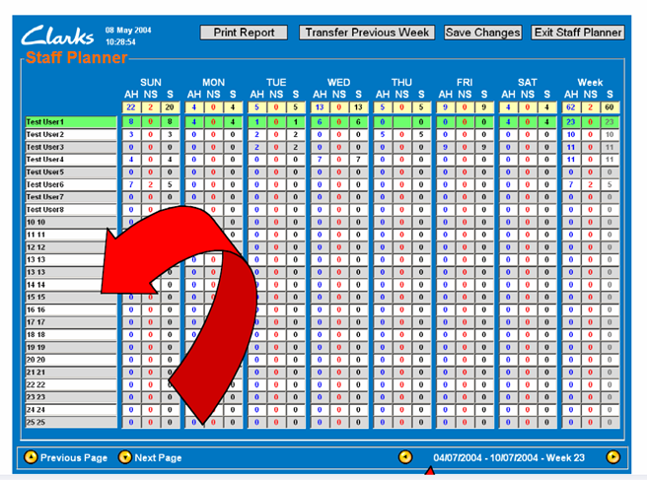
Store Labour Costs – Labour Management in Store
1
2
3
4
5
6
7
1
2
3
4
5
6
7
Store Labour
Observations & Findings
Overview
Findings
There are significant manual processes and duplication in store labour planning, labour management and reporting. This causes a high degree of inefficiency and lost productivity
The stores use a variety of methods / systems to build and record their rosters. These have generally been developed locally, and are not supported by any standardised system. A single system is used to report hours to Head Office each week, but there is a need to re-key data
Employee hours worked are also recorded by day and entered into the STARS system for staff incentive purposes. STARS is a standalone system
Stores also record hours worked separately and submit to payroll each month
These processes are managed separately, where the base data of hours by employee remains the same. The manual re-keying and multiple sources/locations of data appears hugely inefficient from a labour optimisation perspective.
The ability for stores and central teams to obtain quality and timely management information is also compromised by these disparate systems and processes
Benchmarking
Labour
Flexibility
Labour
Management
Store Stock
Management
Leading Practice
A single in-store Labour Management system functioning as a labour scheduling tool, workload planner, rostering tool and time and attendance system.
Good quality data and reporting, ability to measure actual labour against key workload drivers.
Area mangers drive store managers to internal Wage percentages – daily, weekly, monthly
Customer
Service
Lack of standardised approach to labour management in store
Processes are generally inefficient and time-consuming
Current approach provides little access to quality management info

Slide 79
Store Labour Costs – Labour Management in Store
1
2
3
4
5
6
7
1
2
3
4
5
6
7
Store Labour
Observations & Findings
Overview
Recommendations
Review current tools at store and identify opportunities to minimise duplication and error
Identify and share suggested best-practice to streamline processes as a quick win prior to any long-term solution deployment
Examine the potential for a single system, providing synergies in store, removing duplication and inefficient manual processes
The system should be integrated with SAP BW to provide quality information allowing improved management at store, region and company level
The system would tie together all process involved in Rostering, Labour Management and Time & Attendance.
Improvement in this area will be vital to managing long term achievement of workload based labour goals.
Deployment of labour management tools into store is out-of-scope for this phase of Fusion
25
Benchmarking
Labour
Flexibility
26
Labour
Management
Store Stock
Management
Implementation Challenges
People
Process
Technology
Financial
3rd Parties
25
26
Customer
Service
Short-term goal must be to standardise process across stores
System-based opportunities must be carefully considered
System solution must streamline all labour management processes

Slide 80
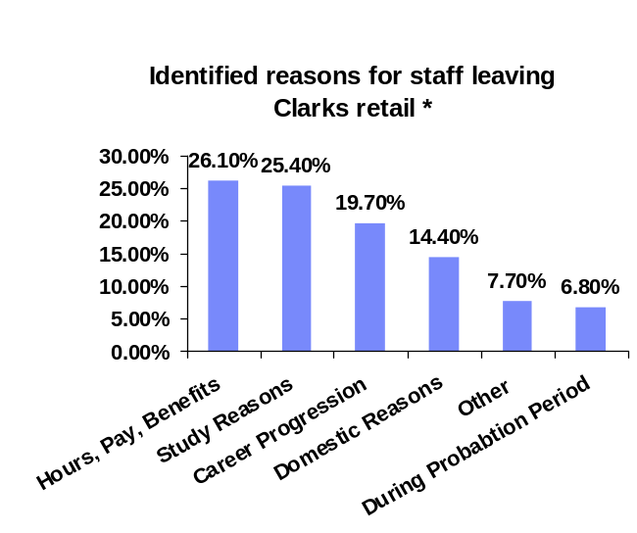
Store Labour Costs – Manager and Staff Turnover
1
2
3
4
5
6
7
1
2
3
4
5
6
7
Store Labour
Observations & Findings
Overview
Findings
Current Staff turnover is around 50% per year in the Clarks business and Store Manager turnover is in excess of 20%. Key reasons for leaving are ‘Hours, Pay and Benefits’ and ‘Career Progression’ **
Leading practice retailers are focused on driving down these turnover rates. Whiles not excessive in the UK, Clarks could drive to a lower turnover and potentially increase sales and profitability
These leading practice retailers will also gear central functions around supporting store performance and optimising store costs. The Clarks model appears to be driven more by localised measures. This can cause sub-optimal performance, and generate frustration within store management teams
High staff turnover impacts on the consistency of the customer service level and on adherence to store policy and processes. This typically causes a gradual erosion of best-practice across the store base
Time involved in recruiting new staff and training is significant (estimates of up to 8-12 weeks before new staff member is operating at level required). This has a substantial impact on sales and customer service
Benchmarking
Labour
Flexibility
Labour
Management
Store Stock
Management
Leading Practice
Retail businesses have a culture that is heavily store and customer focused. They make working in stores a real career option
Although pay is clearly a key driver, many retailers have worked hard at the overall package to attract and retail the best people, e.g. career plans, work-life balance
‘Stores are king’ in many retailers, with head-office seen a playing the support role
Customer
Service
**Based on survey data
collected from store
managers,.
Staff turnover is a sizeable issue that must be addressed
Store management turnover is high and not seen as a career in Clarks
The whole package needs to be considered when addressing churn

Slide 81
Store Labour Costs – Manager and Staff Turnover
1
2
3
4
5
6
7
1
2
3
4
5
6
7
Store Labour
Observations & Findings
Overview
Recommendations
To ensure that employees can be retained Clarks should review why employees are leaving (especially high performers) and determine how to retain valuable staff.
Ensure stores are hiring people that suit the needs of the business and have required level of flexibility so expectations of both parties can be met.
Review current store manager pay and compare to current Industry trend
Retaining good store managers is vital in small store business where number of individuals with deep store knowledge is generally limited.
Establish a formal career plan process and clear career progression for key employees (moving from small store manager to large store assistant to large store manager etc)
The concept of how stores are supported by the central functions needs to be reviewed. A more retail-focused operating model will drive sales and profitability, and improve the performance of the store teams
Any changes in staff terms and conditions, career planning or business culture are policy or organisational decisions. In the first instance, Fusion will have no bearing on Clarks chosen strategy in this area
27
Benchmarking
Labour
Flexibility
Labour
Management
28
Store Stock
Management
Implementation Challenges
People
Process
Technology
Financial
3rd Parties
29
27
28
29
30
Customer
Service
30
The whole remuneration package for Clarks stores must be reviewed
The profile of stores needs to be significantly improved
Developing Store Management as a career in Clarks is key

Slide 82
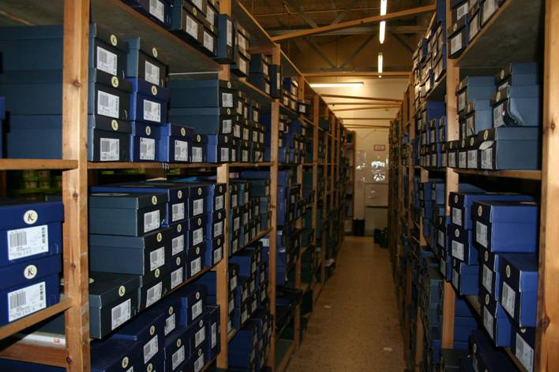
Store Labour Costs – Store Stock Management
1
2
3
4
5
6
7
1
2
3
4
5
6
7
Store Labour
Observations & Findings
Overview
Findings
Stores have no visibility of
  What stock is actually on hand;
  What their inventory pattern is (what stock they will be replenished to);
  What the DC stock position is;
  What stock is in transit / what they will receive today.
With no visibility at the store level the stock management process is highly manual and labour intensive, relying almost entirely on ‘line-of-sight’. This has a direct impact on operating costs in both selling and non-selling activities
Stores are repeatedly looking for the same product or uncovering stock integrity issues but without actual visibility to be certain of a discrepancies they are wary of making any stock adjustments outside of stocktake time.
The stocktake process also is overly labour intensive as staff are required to count number of pairs on each shelf prior to the actual count which is then performed with a bar code reader by an Auditor
Benchmarking
Labour
Flexibility
Labour
Management
Store Stock
Management
Leading Practice
Stores have full visibility of stock on hand, DC stock position and what is in transit.
Stores have full ability to manage their stockholding
Stockfile management is a continual (rolling) process with a certain % of stock being counted and if necessary corrected each week.
Stores utilise RF technology to increase efficiency and effectiveness of the rolling stocktake process
Customer
Service
Stores do not have the basic tools to manage stock
All stock management processes are highly labour intensive
Labour efficiency and service suffer directly from lack of visibility

Slide 83
Store Labour Costs – Stock Management and Stock Takes
1
2
3
4
5
6
7
1
2
3
4
5
6
7
Store Labour
Observations & Findings
Overview
Recommendations
As per “Causes of Poor Availability –
Store Book-Stock Accuracy & Visibility”
  Provide visibility of stockfile
  Exception reporting
  System interrogation
  Cycle counts / focus counts
  PDA deployment
  Upstream visibility: tomorrow’s delivery
  Non-availability capture
Provide stores visibility of stock and hence the ability of manage it. This should give significant labour savings in stores
Estimates from sample stores suggest this could be anywhere from ½ - 3 hours per day per store – approx £500K*)
Cease double counting at stocktake and investigate possibility of allowing stores access to RF technology to count stock. This could be conducted with increased frequency, with RF units shared across regions
Stock takes interfaced into SAP will provide an opportunity to analyse pattern of variances using historical data along with financial valuations
Carrier claims process will allow monitoring of any delays in updates to store receipts and highlighting stocks lost in transit
Benchmarking
Labour
Flexibility
Labour
Management
15
Store Stock
Management
Implementation Challenges
People
Process
Technology
Financial
3rd Parties
31
Customer
Service
31
*Assuming ½ stores on
minimum roster and will
not achieve any £ benefit
Recommendation 15 will deliver significant op cost reduction
Savings to current cost base are in the region of £0.5m
The current stocktake process
can be streamlined

Slide 84
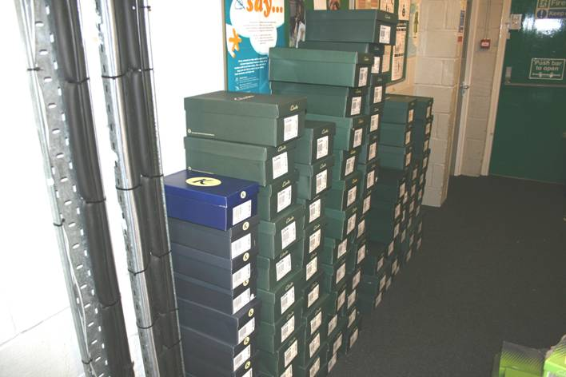
Store Labour Costs – Store Deliveries
1
2
3
4
5
6
7
1
2
3
4
5
6
7
Store Labour
Observations & Findings
Overview
Findings
The majority of stores do not get deliveries within an allocated time window. This makes it hard to plan labour requirements, particularly as they have no forward visibility of consignment size
For many stores their delivery arrives at their peak period of trade taking valuable time away from serving the customer at the ‘opportunity’ time of day
Delivered packs contain multiple SKU’s in no order other than by gender. A single SKU may be split among multiple packs and mixed with other items. The impact of the current delivery configuration is that deliveries must be unpacked, sorted and collated before they can be put away.
Delivery configuration has a direct impact on labour productivity, with indicative costs ranging from 1-2 hours a day in a small store to more than 8 hours a day in the larger stores.
Process inefficiency in these areas is exacerbated where stores have tight backroom space in which to manage deliveries
Benchmarking
Labour
Flexibility
Labour
Management
Store Stock
Management
Leading Practice
Stock is delivered in a manner designed to speed up the put-away process (reducing time spent and making stock available for sale sooner).
Stock is delivered to store within a allocated time-window.
Stores have visibility of what stock is expected to be delivered to store.
Customer
Service
Delivery schedule variances compromise labour planning
Many store deliveries happen at peak trading times
Sortation of deliveries prior to putaway is hugely labour intensive

Slide 85
Store Labour Costs – Store Deliveries
1
2
3
4
5
6
7
1
2
3
4
5
6
7
Store Labour
Observations & Findings
Overview
Recommendations
Change the configuration of the delivery so that the stock arrives in a pattern that matches the stores stockroom (Adults by gender, alphabetically and by style; Kids by size and width). Look at flagging ‘new’ lines separately from replenishment stock
Typically IBM would expect an automated Distribution Centre to be able to provide this service, and although there may be some on-cost in terms of cube utilisation, these will be far outweighed by store benefits
Estimates of the time this would save (based on sample stores) range between ½ an hour in a small store to 4-5 hours a day in a large store) which is worth approx £800K.
Investigate deliveries within a time window.
Stores should get forward visibility of volume stock they are due to receive
Stock deliveries arriving within a time window and visibility of how much stock is to be delivered would allow stores to better plan and manage their labour and roster more effectively.
SAP will spilt the pick tickets by department. This will provide ability to pick, pack and despatch the goods by department.
Stock in transit information will be available for stores on the intranet allowing space and labour planning for expected deliveries from the DC
32
Benchmarking
Labour
Flexibility
Labour
Management
Store Stock
Management
Implementation Challenges
People
Process
Technology
Financial
3rd Parties
32
Customer
Service
11
* Assuming ½ stores on minimum roster and will not achieve any £ benefit
Store-friendly delivery configuration a huge opportunity
Improved deliveries (timing, pre-advice etc.) drive store efficiency
Store savings anticipated
at around £0.8m

Slide 86
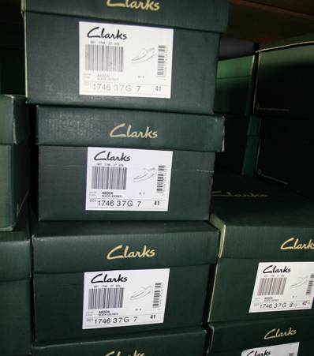
Store Labour Costs – Product Labelling
1
2
3
4
5
6
7
1
2
3
4
5
6
7
Store Labour
Observations & Findings
Overview
Findings
The labels on the outside of the shoe boxes are heavily relied upon in store to locate stock in an expedient manner.
Finding an individual Style and Size in a store stock room filled is difficult and inefficient with the current labelling format.
Currently it appears that there is little or no input from store operations on product decisions and the impact they could have on store processes.
For example: Boots are now available in ‘Normal’ and ‘Wide’ fit, however, there is no quick way to distinguish other than to compare physical size
Benchmarking
Labour
Flexibility
Labour
Management
Store Stock
Management
Leading Practice
Recommendations
As part of their focus on store efficiency, many own-brand retailers will engage their store operations teams in the design of packaging and labelling
Retail Ready Packaging is a major initiative in several retail sectors, focused on both availability and store operating costs.
Review current labelling, ensure it supports an efficient store operations and improve if necessary.
These could be improved by making the ‘Style’ text and size # larger and hence making it quicker and easier to locate in the stockroom.
When developing new products someone from retail operations should be in a position to provide input to ensure product decisions will support efficient store processes.
33
Customer
Service
Box labelling poorly designed from a line-of-sight perspective
Labelling causes Labour inefficiencies & stock inaccuracies
Store operations need to play a key part in label design process

Slide 87
Store Labour Costs – Customer Service
1
2
3
4
5
6
7
1
2
3
4
5
6
7
Store Labour
Observations & Findings
Overview
Findings
Presently stores spend between 1 and 7 hours on phone calls every week. These are a mix of incoming customer enquiries and outgoing calls to the central telesales team
Incoming calls relate to issues such as stock availability, store opening hours, store location, stock quality, or general stock policy (refunds / returns). The most frequent time for customer calls is during the stores peak period of trade, impacting on customer service and employee productivity
There is a lack of integration across channels within Clarks. For example, the Clarks website does not provide customers with store-specific information that would enable a significant reduction in call volumes
Outgoing call volumes are significant. Up to 2,000 calls per day are being made across all stores to the telesales team enquiring about stock availability and placing Special Orders. Naturally this is a labour intensive process directly impacting on store labour costs
Benchmarking
Labour
Flexibility
Labour
Management
Store Stock
Management
Leading Practice
A single National phone number for all queries that will direct callers to the appropriate voice recorded answer in the case of trading hours / store locations etc, or to a single call centre to handle most other customer queries.
Allows sales people to focus on in-store customers particularly at peak trade
Store opening hours and other details available through retailer’s web-site
Customer
Service
Stores spend up to 7 hours per week handing customer calls
Calls are often received during peak trading hours
Clarks does not manage customer communications effectively

Slide 88
Store Labour Costs – Customer Service
1
2
3
4
5
6
7
1
2
3
4
5
6
7
Store Labour
Observations & Findings
Overview
Recommendations
A single national number could be utilised, advertised as the number for all stores, that presents callers with a recorded automated menu system that would identify best response to their call
The basic queries (store trading hours, location etc) could easily be answered by an automated voice response
The majority of other queries are stock related (either availability, returns or quality) and are best handled through a central call centre allowing consistent service and a central point for management
Additional information to try and pre-empt calls could be placed on the website, however it must be readily locatable
As part of Clarks multi-channel strategy definition, potential opportunities to support retail should be considered. This would include, for example, publishing locations and opening hours on the web-site
All processes pertaining to store customer call handling are out-of-scope for this phase of Fusion
34
Benchmarking
Labour
Flexibility
Labour
Management
Store Stock
Management
Implementation Challenges
People
Process
Technology
Financial
3rd Parties
33
34
Customer
Service
35
A national number for all calls would save significant store time
Customer queries can be answered faster and more consistently
Other media should be used to resolve queries without calling

Slide 89
1
2
3
4
5
6
7
1
2
3
4
5
6
7
Opportunity Priorities
& Roadmap
Opportunity Priorities & Roadmap
1
2
3
4
5
6
7
Executive Summary
Background Scope and Approach
Financial Analysis & Industry Drivers
Availability
Findings & Obser-vations
Store Labour
Findings & Obser-vations
Opportunity Priorities & Roadmap
Prioritised Case for Action

Slide 90
We have used the following criteria to assess the potential implications for Clarks
1
2
3
4
5
6
7
1
2
3
4
5
6
7
Opportunity Priorities
& Roadmap
Availability
Potential material improvement
No material improvement
Margin
Significant potential
for margin improvement
No potential for margin improvement
Store Labour Costs
Significant potential for improvement in store efficiency
No potential for improvement in store efficiency
Cost of Change
Potentially significant
implementation cost
Potentially minimal / no
implementation cost
Complexity of Change
Potentially significant business change
programme required
Minimal or no business change required

Slide 91
Availability: Recommended Initiatives
1
2
3
4
5
6
7
1
2
3
4
5
6
7
Opportunity Priorities
& Roadmap
Focus Area |  | Recommendation | Availability | Margin | Store Labour | Cost of Change | Complexity of Change
 |  | Develop a robust, business-wide measure for retail availability
 |  | Develop a more advanced store replenishment system
 |  | Segment replenishment model by product, store & supply chain dynamics
 |  | Develop ‘quick wins’ using current systems, e.g. Children's best-practice
 |  | Trial variable lead-times and replenishment frequency by segmentation
 |  | Trial in-day polling of sales data for weekend replenishment
 |  | Implement a service level of 72 hours for Customer Orders
 |  | Develop process to use Customer Order data to investigate Out of Stocks
Measurement
1
Replenishment
2
Replenishment
3
Replenishment
4
Replenishment
5
Replenishment
6
Replenishment
7
Replenishment
8

Slide 92
Availability: Recommended Initiatives
1
2
3
4
5
6
7
1
2
3
4
5
6
7
Opportunity Priorities
& Roadmap
Focus Area |  | Recommendation | Availability | Margin | Store Labour | Cost of Change | Complexity of Change
 |  | Revise store processes to ensure customer orders expedited efficiently
 |  | Develop a mechanism for customers to have ‘Special Orders’ delivered to home
 |  | Review timings of all store deliveries in line with segmentation process
 |  | Develop concept of direct store deliveries to reduce cost and transit time
 |  | Introduce Retail KPIs for DC carry-over and ‘order well’ replenishment not pulled
 |  | Generate mechanism to provide store pre-advices of allocations and deliveries
 |  | Give stock file visibility and control to store personnel
 |  | Enable stores to view other store and distribution centre stockholding
Replenishment
9
Replenishment
10
Store Deliveries
11
Store Deliveries
12
Store Deliveries
13
Store Deliveries
14
Book Stock
15
Book Stock
16

Slide 93
Availability: Recommended Initiatives
1
2
3
4
5
6
7
1
2
3
4
5
6
7
Opportunity Priorities
& Roadmap
Focus Area |  | Recommendation | Availability | Margin | Store Labour | Cost of Change | Complexity of Change
 |  | Conduct detailed investigation into causes of store stock file gross variances
 |  | Quantify level of lifecycle distressed stock and identify potential initiatives to clear
 |  | Develop a cost-to-serve model to understand true product-level profitability
 |  | Identify opportunities to rationalise the SKU range using cost-to-serve modelling
 |  | Develop a strategy for a more robust and responsive upstream supply chain
Book Stock
17
Complexity & Margin
18
Complexity & Margin
19
Complexity & Margin
20
Complexity & Margin
21

Slide 94
Store Costs: Recommended Initiatives
1
2
3
4
5
6
7
1
2
3
4
5
6
7
Opportunity Priorities
& Roadmap
Focus Area |  | Recommendation | Availability | Margin | Store Labour | Cost of Change | Complexity of Change
 |  | Perform internal benchmarking on key labour metrics – develop action plan
 |  | Investigate opportunities for a full Labour Management Programme (Torex work)
 |  | Develop understanding of optimal labour mix by store format
 |  | Review current labour management tools and processes currently used in stores
 |  | Examine opportunities for a consistent process for managing labour in store
 |  | Develop formal process to understand reasons for staff attrition
 |  | Benchmark store manager pay against the high-street
 |  | Develop formal career planning process for key store personnel
Benchmarking
22
Benchmarking
23
Labour Management
24
Labour Management
25
Labour Management
26
Labour Management
27
Labour Management
28
Labour Management
29

Slide 95
Store Costs: Recommended Initiatives
1
2
3
4
5
6
7
1
2
3
4
5
6
7
Opportunity Priorities
& Roadmap
Focus Area |  | Recommendation | Availability | Margin | Store Labour | Cost of Change | Complexity of Change
 |  | Improve the support for stores through a more retail-focused operating model
 |  | Cease double counting process at store stocktakes
 |  | Change configuration of deliveries to ensure store-friendly handling
 |  | Review product labelling and include retail in design process
 |  | Provide a single national number as first-line for all incoming telephone calls
 |  | Ensure retail opportunities are fully incorporated in multi-channel strategy
Labour Management
30
Store Stock Management
31
Store Stock Management
32
Store Stock Management
33
Customer Service
34
Customer Service
35

Slide 96
1
2
3
4
5
6
7
1
2
3
4
5
6
7
Prioritised Case for Action
Opportunity Priorities & Roadmap
1
2
3
4
5
6
7
Executive Summary
Background Scope and Approach
Financial Analysis & Industry Drivers
Availability
Findings & Obser-vations
Store Labour
Findings & Obser-vations
Opportunity Priorities & Roadmap
Prioritised Case for Action

Slide 97
Prioritisation of the Strategic Initiatives Identified
1
2
3
4
5
6
7
1
2
3
4
5
6
7
Prioritised Case for Action
High
Attractiveness Ranking
2
21
20
15
19
Legend
30
14
18
5
1st
23
3
17
Availability
32
22
1
2nd
Store Labour
6
4
Medium
Business Value
24
3rd
11
16
26
28
12
29
4th
10
33
7
13
34
9
25
5th
Low
8
27
35
31
Note : The circled numbers represent each strategic initiative
Prioritisation is based on high-level assessment of Clarks business and IBM experience
High
Medium
Low
Implementation Effort

Slide 98
The Roadmap of Opportunities Breaks Down Into Three Phases
1
2
3
4
5
6
7
1
2
3
4
5
6
7
Prioritised Case for Action
The road forward, in our view, is straightforward and revolves around getting the basics right, enhanced consistency in execution and developing or obtaining the required skills and competencies.
Phase 1
‘‘What are our quick wins?’
  Robust measure for availability
  Short-term replenishment ‘quick wins’
  KPIs for DC stock carry over and order well
  72 hour lead-time for customer orders
  Investigate causes of gross stock variance
  Quantify lifecycle distress and plan to clear
  Conduct store labour benchmarking
  Formal process to understand staff attrition
  Benchmark manager T’s and C’s
  Formal career planning for store personnel
  Remove double counting from stocktake
  Product labelling
Phase 2
‘What are the tactical initiatives?’
  Segmented replenishment model
  Variable delivery frequency and lead-times
  Customer order availability measure
  Direct store deliveries
  Stockfile visibility and control
  Review and revise store delivery schedules
  Pre-advice for allocated & despatched stock
  Process revision for customer orders
  Cost-to-Serve modelling
  Understand optimal store labour mix
  Labour management tools
  Consistent store labour processes
  Store-friendly deliveries
  Single national call-centre
Phase 3
What are the strategic initiatives?’
Visibility of stock by location
Advanced replenishment system
In-day sales polling
Home delivery for customer orders (as part of multi-channel strategy)
Range rationalisation
Strategic review of upstream supply chain
Labour management programme
Improve retail-focus of central functions
Retail consultation in multi-channel
1
3
4
16
5
13
2
8
6
7
12
17
15
10
18
11
20
22
14
21
27
9
23
28
19
30
29
24
35
31
25
26
33
32
34

Slide 99
Roadmap – Phase 1
1
2
3
4
5
6
7
1
2
3
4
5
6
7
Prioritised Case for Action
A phased programme of activity is proposed for Clarks in order to undertake the necessary process and other structure initiatives that are required to drive greater performance and in the longer term, enhanced Retailer sales and profits.
Phase 1
‘‘What are our quick wins?’
  Robust measure for availability
  Short-term replenishment ‘quick wins’
  KPIs for DC stock carry over and order well
  72 hour lead-time for customer orders
  Investigate causes of gross stock variance
  Quantify lifecycle distress and plan to clear
  Conduct store labour benchmarking
  Formal process to understand staff attrition
  Benchmark manager T’s and C’s
  Formal career planning for store personnel
  Remove double counting from stocktake
  Product labelling
Q1 - 06
Q2 - 06
Q3 - 06
Q4 - 06
Q1 - 07
Q2 - 07
Q3 - 07
Q4 - 07
1
4
13
7
17
18
22
27
28
29
31
33
Milestones:
Fusion ‘Go-Live’
CIPR1 / Release 3a
CIPR 2

Slide 100
Roadmap – Phase 2
1
2
3
4
5
6
7
1
2
3
4
5
6
7
Prioritised Case for Action
A phased programme of activity is proposed for Clarks in order to undertake the necessary process and other structure initiatives that are required to drive greater performance and in the longer term, enhanced Retailer sales and profits.
Phase 2
‘What are the tactical initiatives?’
  Segmented replenishment model
  Variable delivery frequency and lead-times
  Customer order availability measure
  Direct store deliveries
  Stockfile visibility and control
  Review and revise store delivery schedules
  Pre-advice for allocated & despatched stock
  Process revision for customer orders
  Cost-to-Serve modelling
  Understand optimal store labour mix
  Labour management tools
  Consistent store labour processes
  Store-friendly deliveries
  Single national call-centre
Q1 - 06
Q2 - 06
Q3 - 06
Q4 - 06
Q1 - 07
Q2 - 07
Q3 - 07
Q4 - 07
3
5
8
12
15
11
14
9
19
24
25
26
32
34
Milestones:
Fusion ‘Go-Live’
CIPR1 / Release 3a
CIPR 2

Slide 101
Roadmap – Phase 3
1
2
3
4
5
6
7
1
2
3
4
5
6
7
Prioritised Case for Action
A phased programme of activity is proposed for Clarks in order to undertake the necessary process and other structure initiatives that are required to drive greater performance and in the longer term, enhanced Retailer sales and profits.
Phase 3
What are the strategic initiatives?’
Visibility of stock by location
Advanced replenishment system
In-day sales polling
Home delivery for customer orders (as part of multi-channel strategy)
Range rationalisation
Strategic review of upstream supply chain
Labour management programme
Improve retail-focus of central functions
Retail consultation in multi-channel
Q1 - 06
Q2 - 06
Q3 - 06
Q4 - 06
Q1 - 07
Q2 - 07
Q3 - 07
Q4 - 07
16
2
6
10
20
21
23
30
35
Milestones:
Fusion ‘Go-Live’
CIPR1 / Release 3a
CIPR 2

Slide 102
Action Plan
1
2
3
4
5
6
7
1
2
3
4
5
6
7
Prioritised Case for Action
Action Plan – Where to Start
Pre-requisites
Define the key measures for availability – Ensure business-wide buy-in to the calculation method
Develop Programme Management principles to ensure initiatives are effectively managed
Create governance framework to determine who is Responsible, Accountable, Consulted & Informed
Ensure the required resource is committed, and the best people are allocated to the programme
Develop and execute communications plan to ensure availability is on everyone’s agenda
Develop a cross-functional steering committee with executive sponsorship
Phase 1
‘Quick Wins’
Undertake rapid assessment of implementation costs, benefits, risks etc.
Agree which Phase 1 initiatives can be achieved within 6 months without major business change
Assign initiative ownership (cross-functionally where relevant)
Agree deliverables, milestones and critical success factors
Phase 2
‘Tactical Initiatives’
Undertake rapid assessment to understand which initiatives can deliver a trial within 6 months
Develop Terms of Reference for initiatives to be taken forward, and gain sign-off from functional owners
Define and mobilise small cross-functional teams to focus on delivering a low-cost, measurable trial
Phase 3
‘Strategic Initiatives’
Review Tactical Initiatives considered too large to deliver trial within 6 months
Agree strategic initiatives to investigate further and develop Terms of Reference. This should focus chiefly around development of a business case, with clear understanding of go / no-go decision factors
Identify milestones for business case sign-off and individual initiative roadmap

